Slide 1
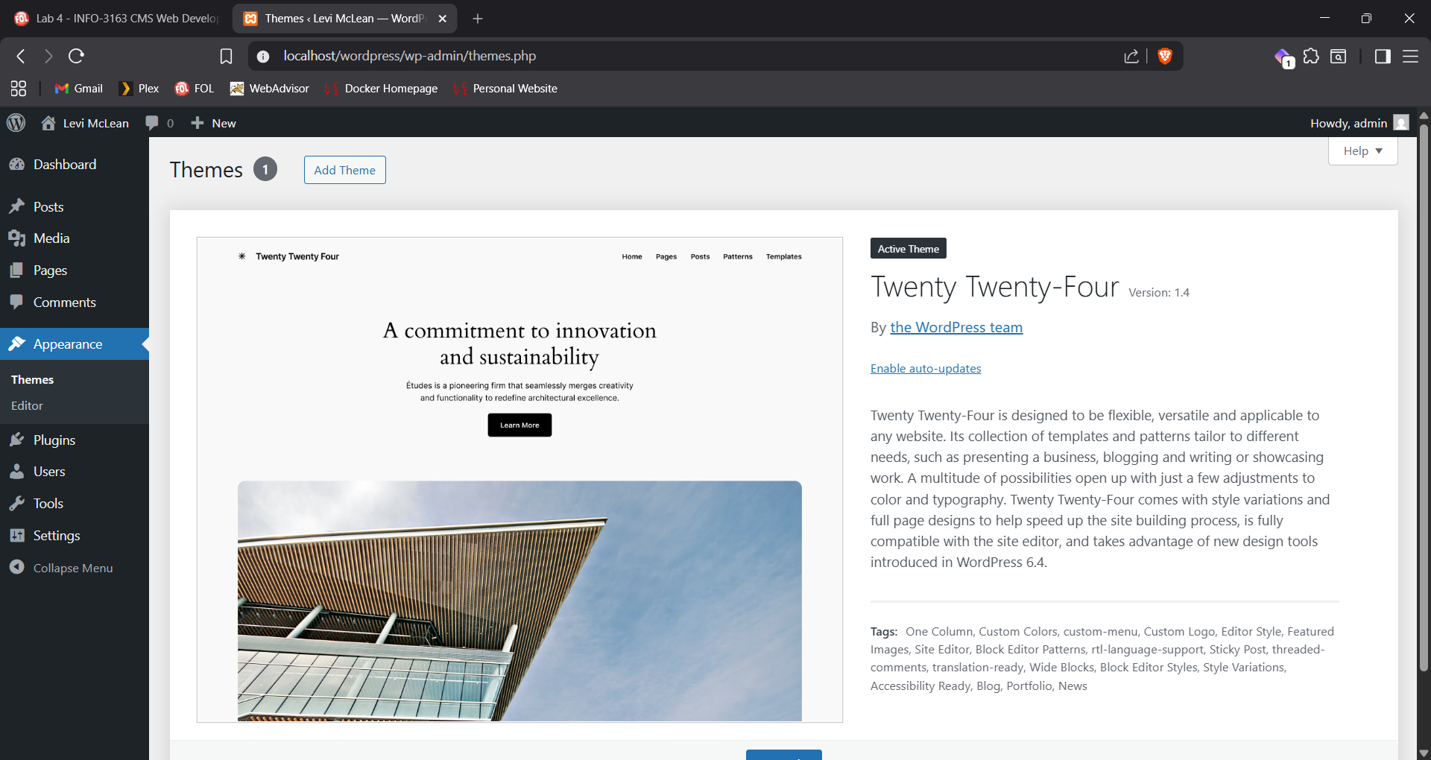
Screenshot #1

Slide 2
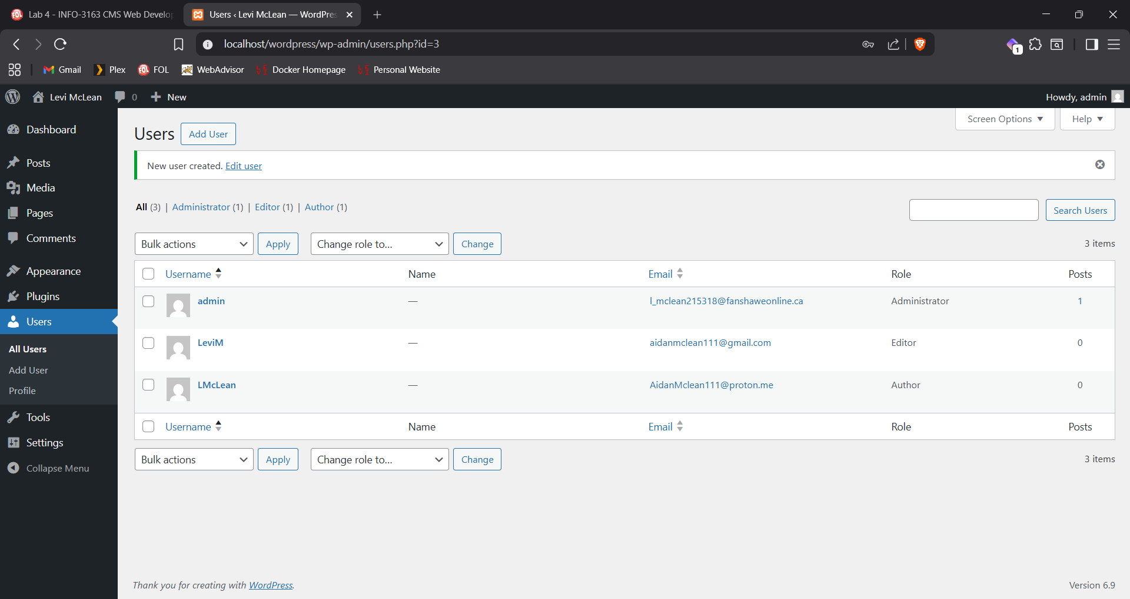
Screenshot #2

Slide 3
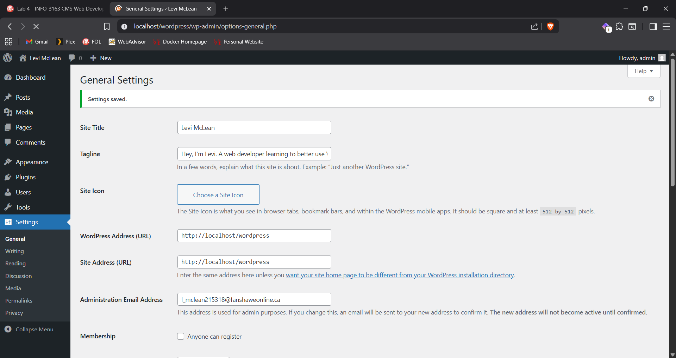
Screenshot #3

Slide 4

Screenshot #4

Slide 5
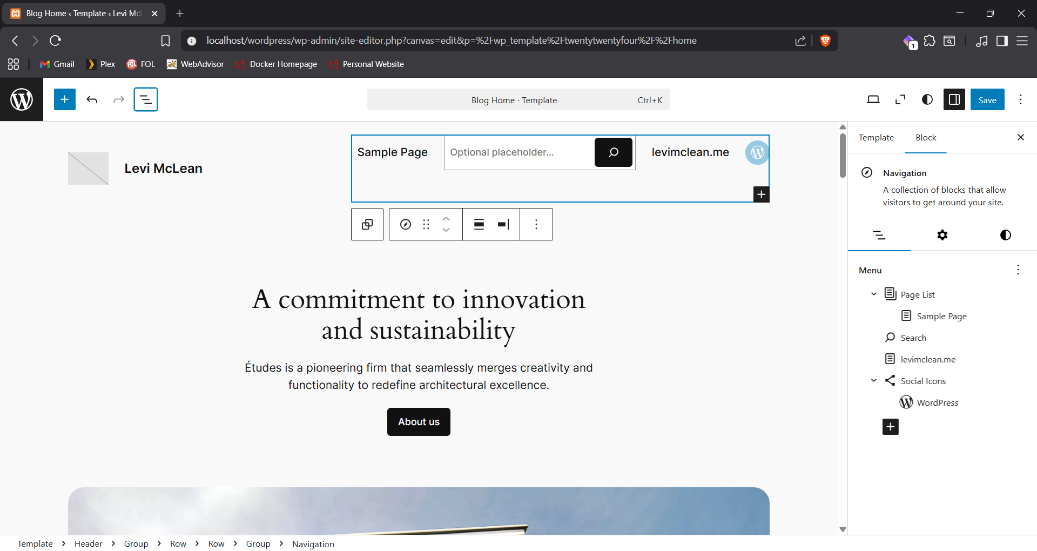
Screenshot #5

Slide 6
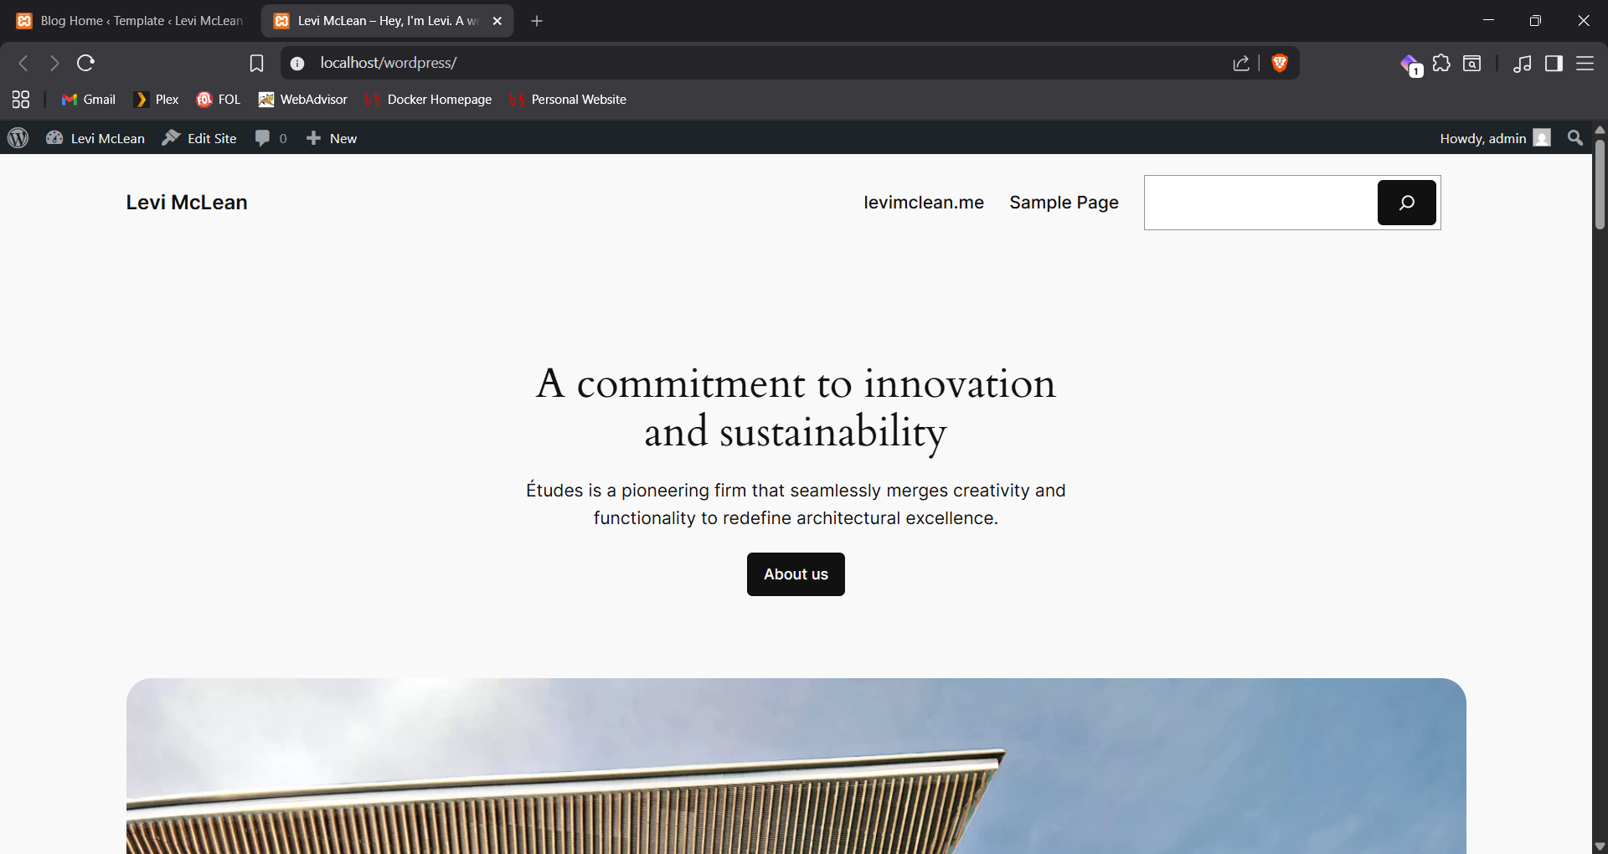
Screenshot #6

Slide 7
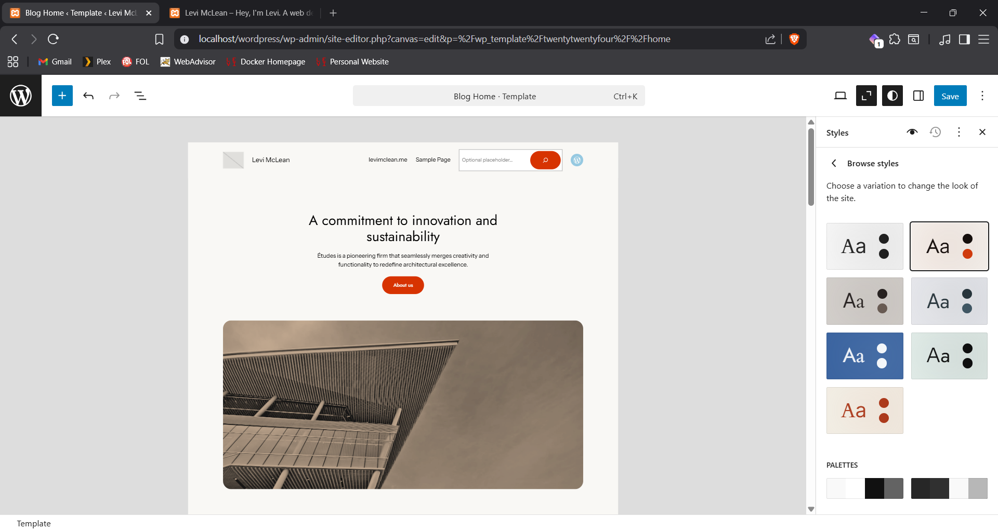
Screenshot #7

Slide 8
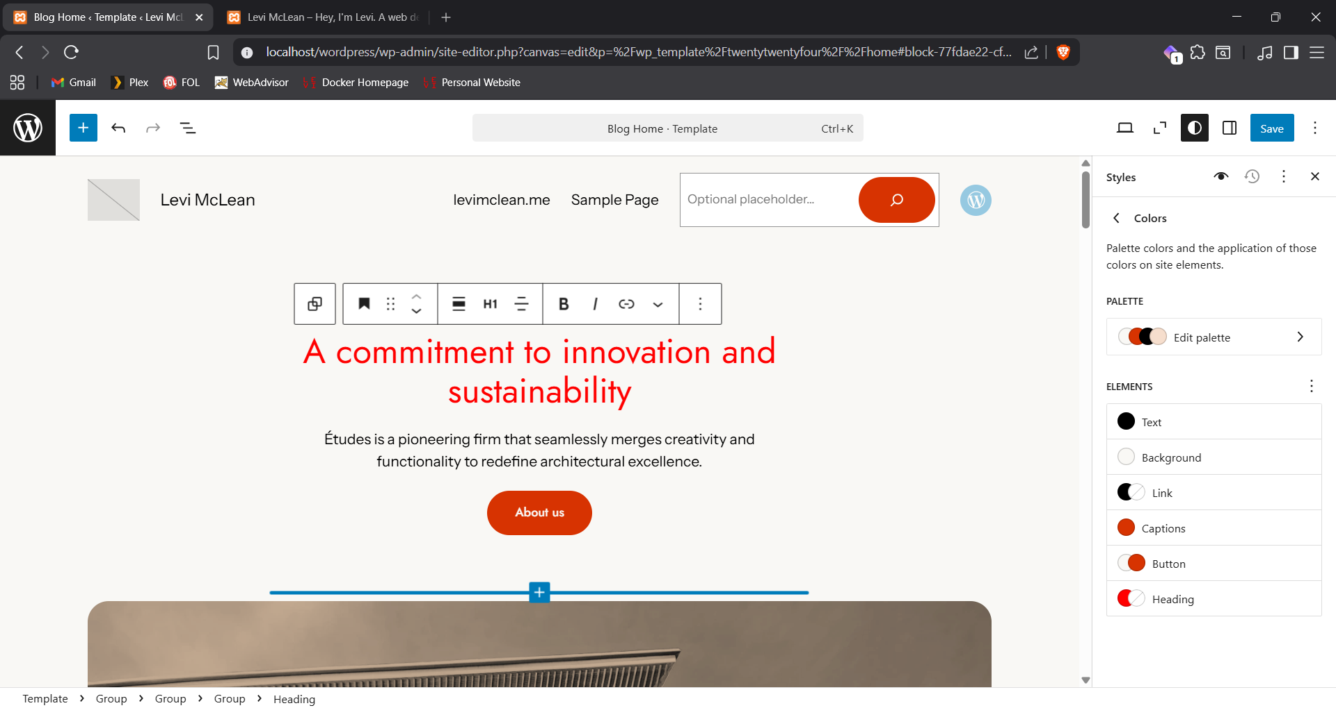
Screenshot #8

Slide 9
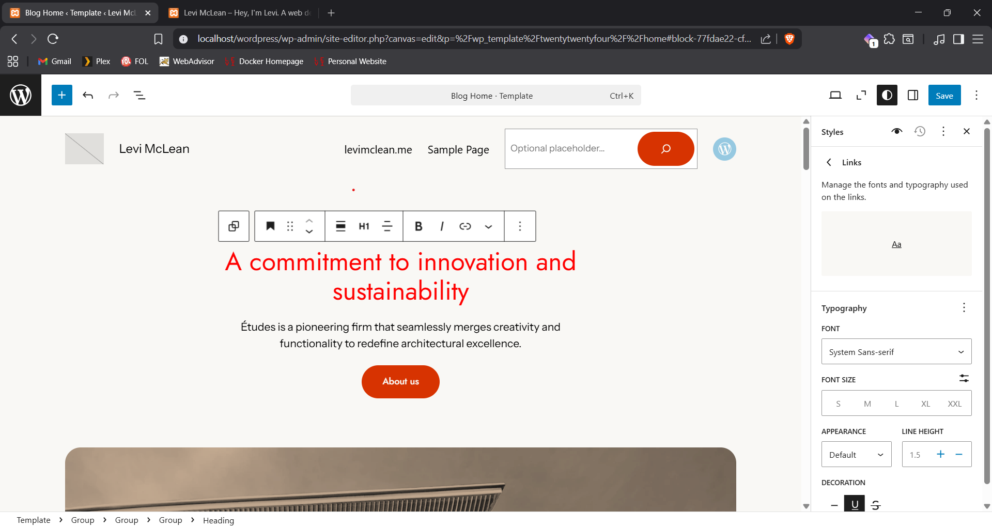
Screenshot #9

