Slide 1
INFO-3163-01 Levi McLean Lab1

Slide 2
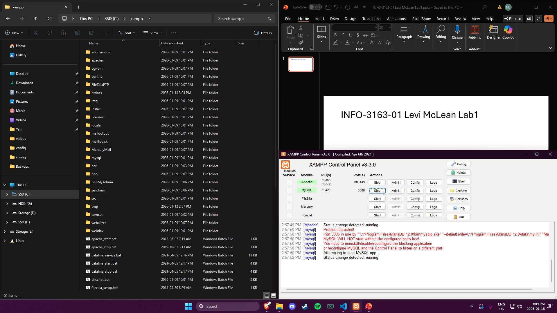

Slide 3
