Slide 1
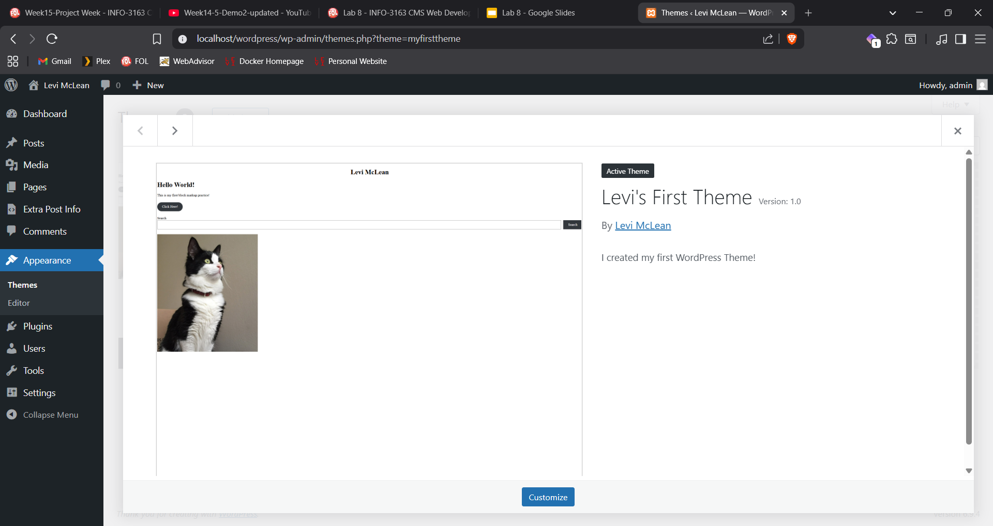
Screenshot 1

Slide 2
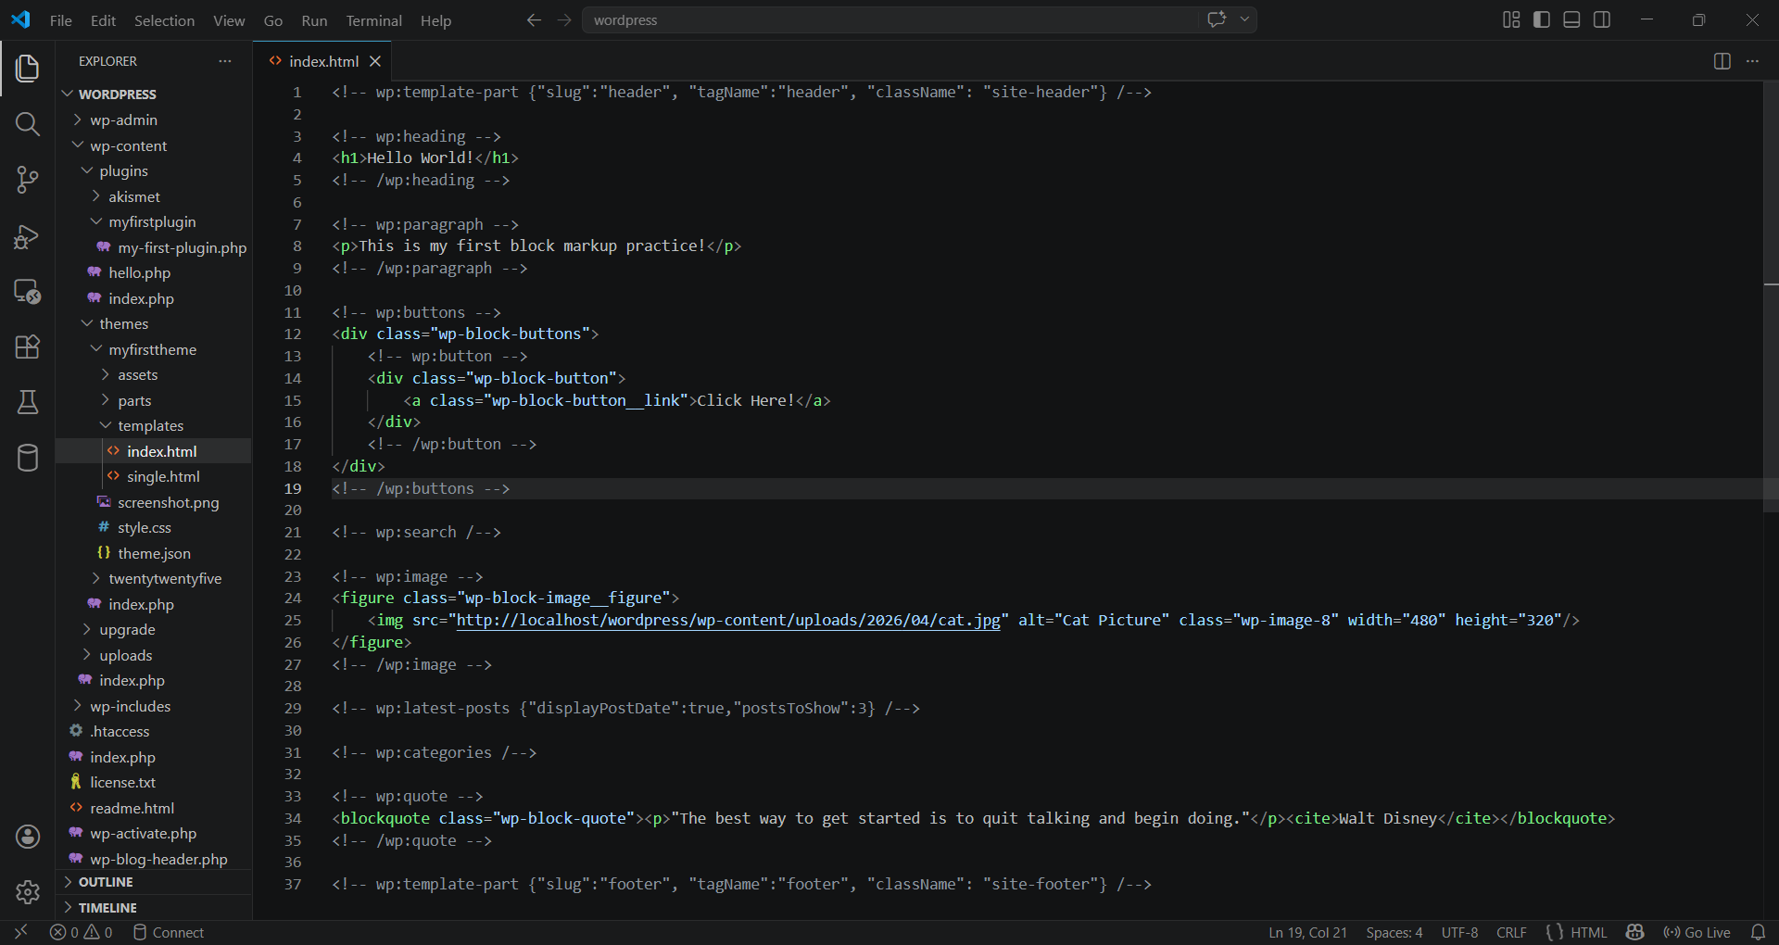
Screenshot 2

Slide 3
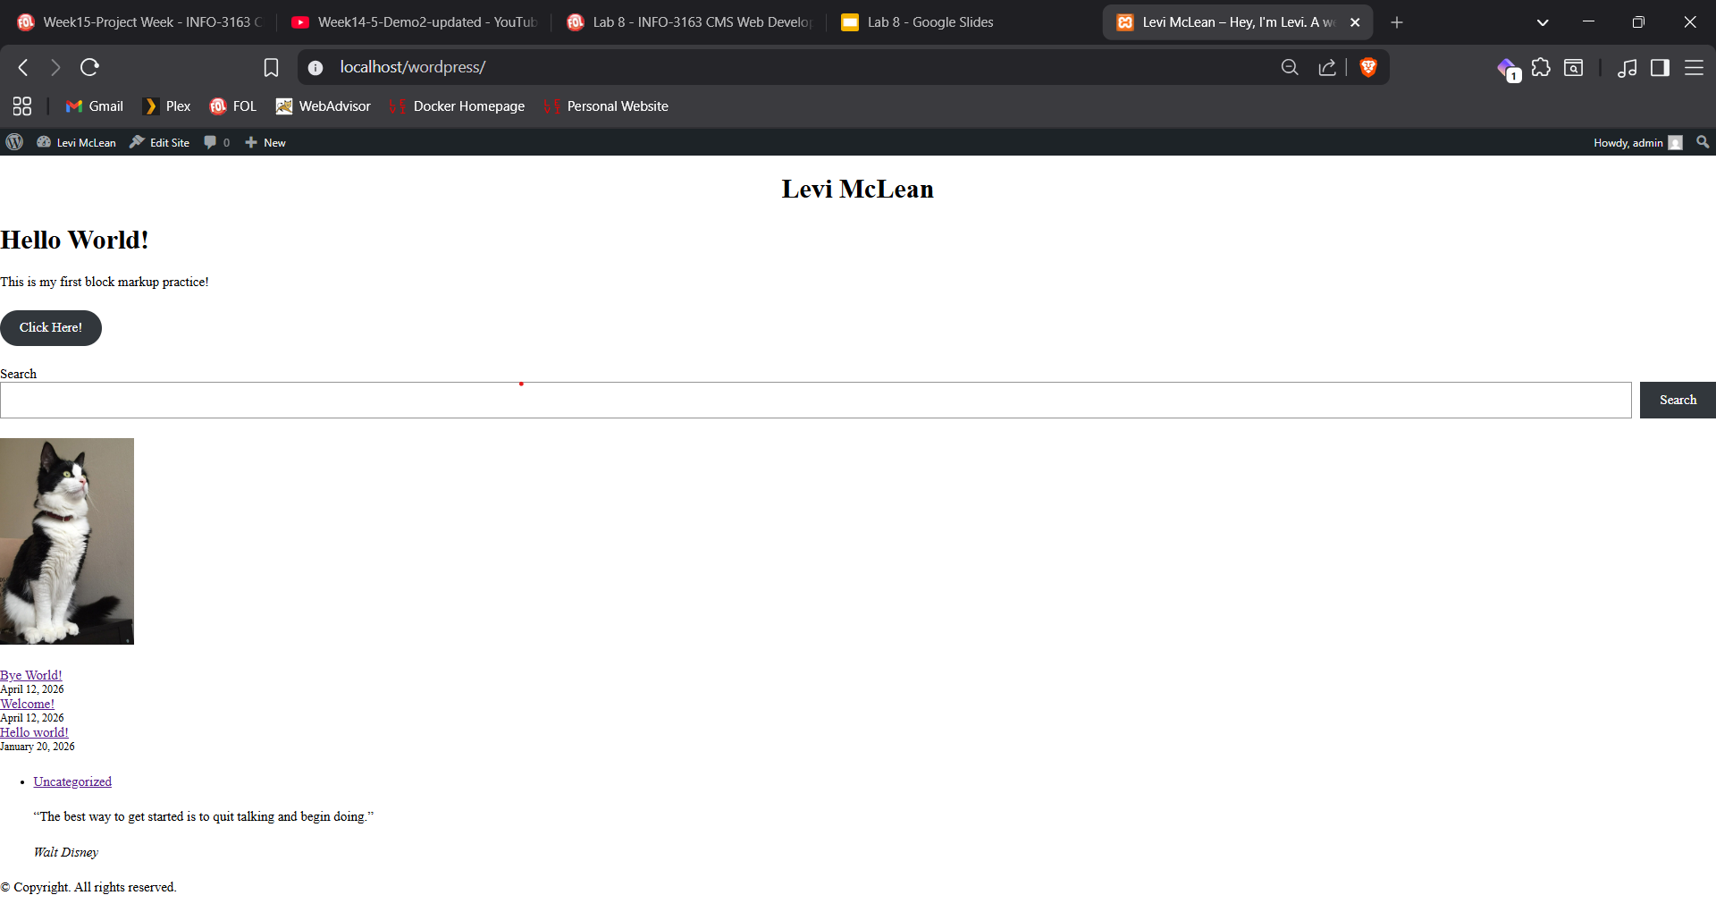
Screenshot 3

Slide 4
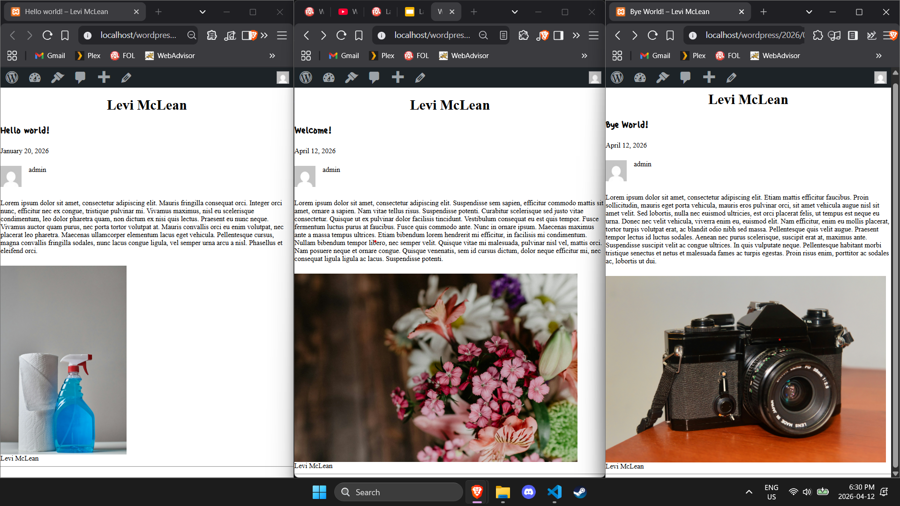
Screenshot 4

Slide 5
Screenshot 5

Slide 6
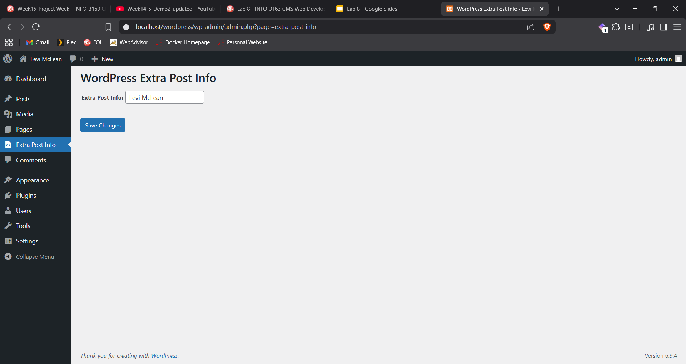
Screenshot 6

Slide 7
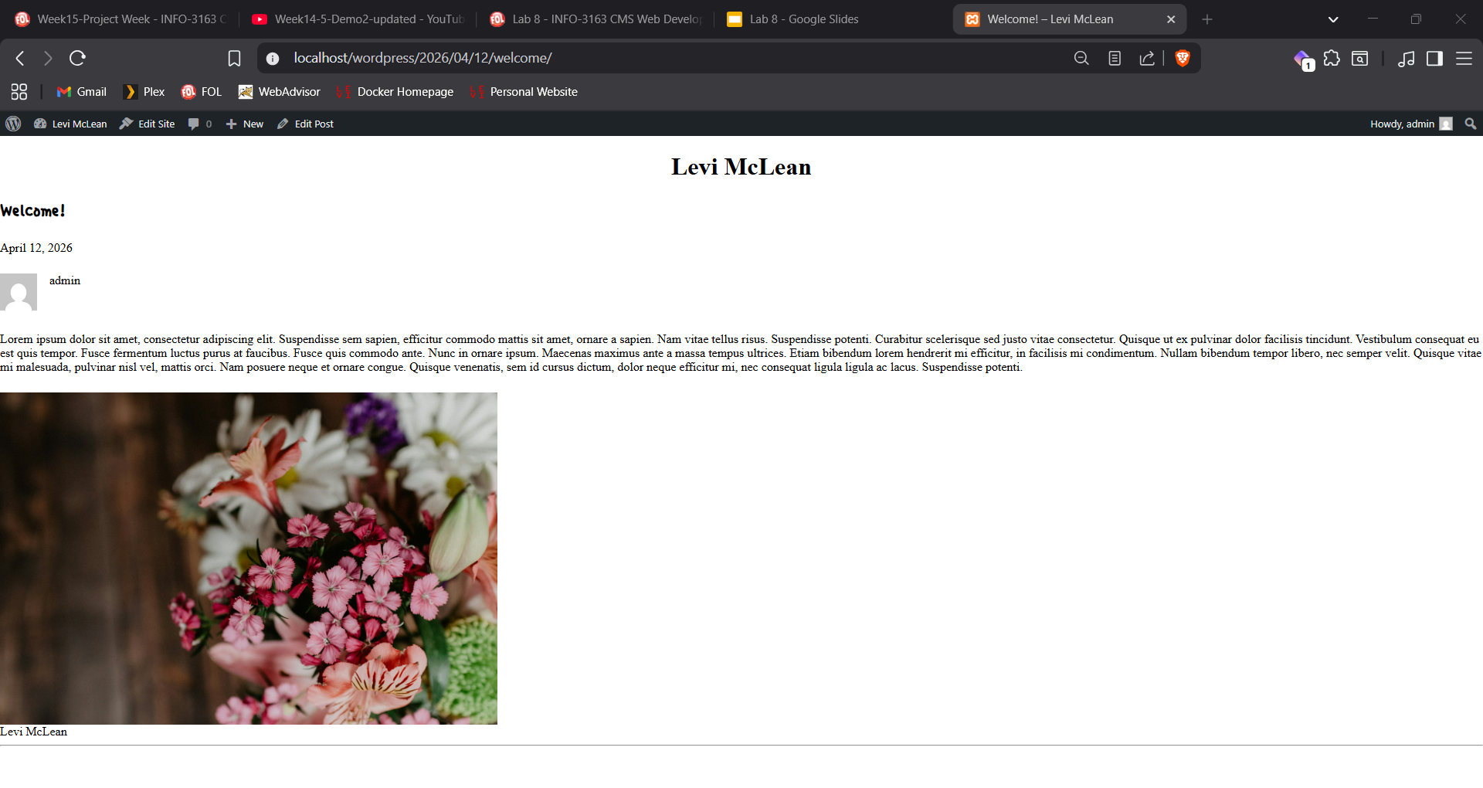
Screenshot 7

Slide 8

Screenshot 8

Slide 9
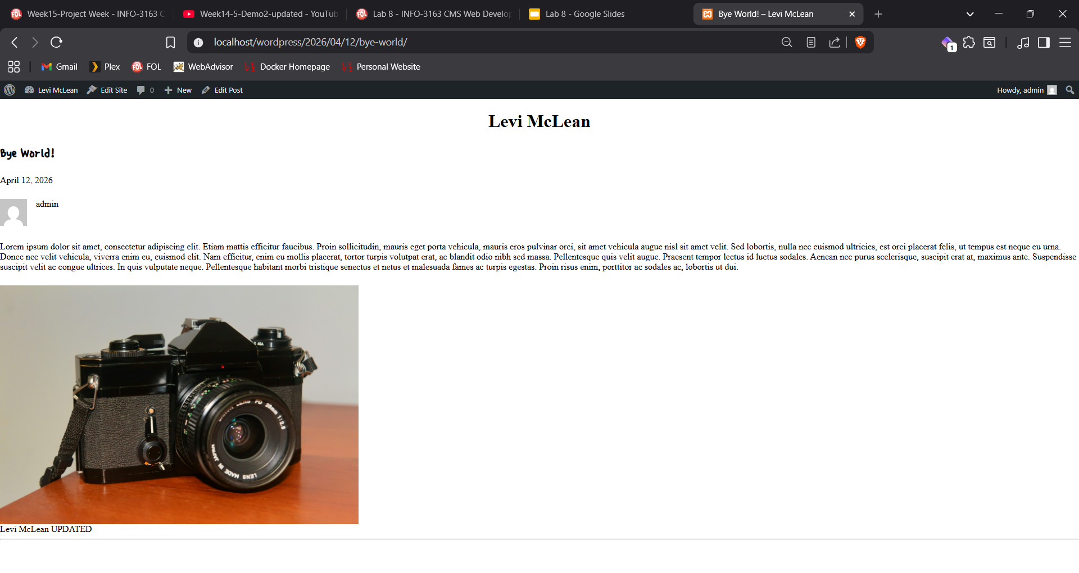
Screenshot 9

