Slide 1





INFO-1274
Introduction
INFO-1274: Graphic Design for Web Developers
INTERNET APPLICATIONS & WEB DEVELOPMENT

Slide 2
Today’s Class
Professor Introduction
Course Policies
Course Evaluation (Grading Breakdown)

Slide 3
Course Policies
CHEATING - All forms of cheating are considered an academic offence and the College has a clear policy on cheating. There is zero tolerance for any forms of cheating.
PLAGIARISM - Plagiarism is cheating and a serious academic offence and an appropriate penalty will be applied if you are found to have plagiarized and a report will be placed in your file.
  Penalties shall range from failure of an assignment to possible failure of the course.
REWRITES - Students cannot make the assumption that any opportunity will be made by the professor to permit a student to rewrite failed assignments or tests.

Slide 4
Fanshawe Online
Keep up to date on course home page for updates.
Links to classes can be found in the week’s module, FOL calendar or through the Pulse App.
I will remind you as best I can regarding important events, due dates, tests
Dates are ultimately your responsibility.
Your attendance and participation is important in this course
Attendance is crucial for course education, labs and tests

Slide 5
Grading & Evaluations
Tests - 2 x 10% each = 20% course mark
Labs – 4 x 7.5% each = 30% course mark
Projects – 2 x 25% =50% course mark

Slide 6
Tests: 20%
FOL based
Multiple Choice, True False, Matching, Ordering & practical questions
Tests will be held in normally scheduled class time
No lecture or lab material after tests
Tests may also include questions regarding lab work

Slide 7
Labs: 30%
Lab work will be assigned every week, but you will only be marked on 4 of them (refer to the semester at a glance). I’ll also clearly put a comment at the top of each weeks lesson which labs are to be handed in.
Lab work is to be completed and submitted individually
Please make sure your lab is complete, I will not allow you to re-submit if you submitted an incomplete or incorrect file
Late submissions will be penalized at 10% per day, I will not accept labs or project 5 days after their due date
Do not send any lab or project by email, the drop box will remain open 5 days after the lab is due

Slide 8
Culminating Assignments/Projects: 50%
At the completion of each major Adobe software you will be provided an individual or project (photoshop and illustrator)
These assignments are to be completed without assistance from your professor as we’re providing a practical assessment of your skills

Slide 9
Labs and Project File Organization
Put your last name on everything you had in, that includes folder and working files. example Lab 1_LastName
You can then zip that weekly folder as your submitted work
(.zip only, non .rar compression).
All course related files should be stored on at least two different locations, with one required to be on the cloud.
Do not save your files only on the computer you are using!
  Adobe CC Cloud (included in your Fanshawe provided subscription!)
  Google Cloud (free)
  MS OneDrive (free)
Lost File? You know where this is going…

Slide 10


Adobe Creative Cloud
INTERNET APPLICATIONS & WEB DEVELOPMENT PROGRAM

Slide 11
Course Focus Areas
Colour Theory
Graphic Design Principles
Adobe CC Graphic Design Software (Photoshop and Illustrator)
Adobe CC Wireframing Software (XD)

Slide 12
Get Adobe CC
Visit https://connected.fanshawec.ca/adobe/ and use your Fanshawe credentials to sign in. For students, this is username@fanshaweonline.ca
The instructions are on the https://connected.fanshawec.ca/adobe/
If you still need help contact the IT service desk https://connected.fanshawec.ca/

Slide 13

Photoshop
uses pixels to create and
manipulate, edit, enhance images
Resolution dependent
It started as a way for photographers to fix photos but now it it widely used by artists of all kinds
What can Photoshop be used for?
  Create original artwork
  Manipulate color images
  Retouch photographs
  Repair damaged images
  Create images for Web pages
  Motion Graphics
  3D artwork
  Fine art – illustration and painting
Notes:
Photoshop is digital imaging software. While photos may come from a variety of sources with different levels of quality and finishing, you will regularly need to work with these original photos to enhance them. For example, even in photos that are close to print quality, you may need a slight adjustment to exposure or possibly need to remove the red eye from human subjects. You may also use multiple photos to create new images or use special effects available in Photoshop.

Slide 14



Example Photo adjustment, selections

Slide 15
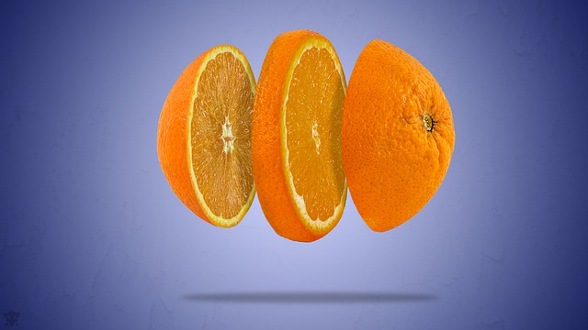
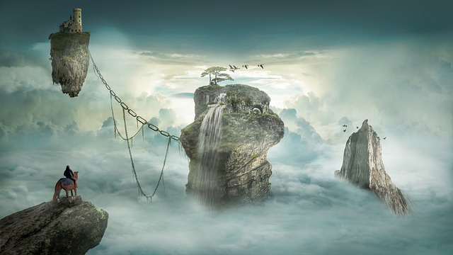
Example Photo composition

Slide 16

Illustrator
This program is used for editing vector-based work such as graphic, logos, illustrations, Vector-based artwork is scalable and can be made as large as you need it to be without losing sharpness
Resolution Independent
What can Illustrator be used for?
Vector based artwork including
  Illustrations
  Logos
  Motion graphics
  3D artwork
  Typography design
Notes:
Illustrator is used to create or edit computer generated graphics (i.e. company logos, facility maps, etc.). Illustrator files are ‘line art’ graphic files or considered to be vector images. Vector images are usually more efficient than bitmap images. Instead of using individually coloured pixels to create an image, vector images use specific ‘areas’ to create images. The way in which an area is described and coloured allows for much larger areas of the same colour. As a result of this type of image handling, images are smoother and much easier to scale. When they are enlarged, the user doesn’t get the “jaggies” like one would get with a bitmap image. When a bitmap image is enlarged, you are making the pixels bigger, which creates more jagged edges. You still have the same number of pixels, but because they are bigger, none of the edges in the images are as smooth as they once were. That is how the “jaggie” effect is easily seen in an enlarged bitmap image.

Slide 17


"Illustration by Dahlov Ipcar" by Crossett Library Bennington College is licensed under CC BY-NC-SA 2.0

Slide 18

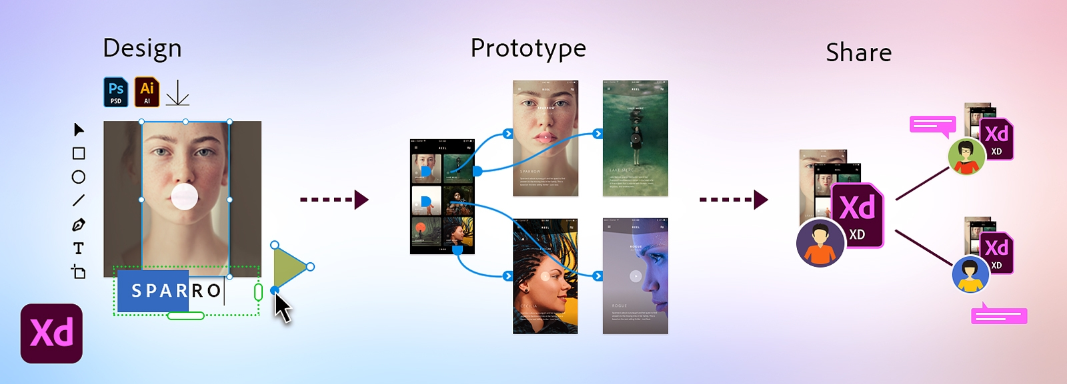
XD - Experience
Vector-based user experience and user interface design tool for sites, web apps and mobile apps
UX and UI mappings
Storyboarding
Wireframing

Slide 19
Course Resources
Linkedin Learning (formerly Linda.com)
Creative Cloud Tutorials
Photoshop Training Channel(YouTube) https://www.youtube.com/c/Photoshoptrainingchannel
Everything Create Cloud (keynote speakers, design and technical tutorials, special projects)
https://www.youtube.com/c/AdobeCreativeCloud
If you have a specific question or something is not functioning the way you think it should, google the question. 99% of the time I’ve found an answer on a forum or video.

