Slide 1
Module 1
Colour Theory and Photoshop

Slide 2

Colour Theory

Slide 3
Colour Properties
HUE (Colour) – Is just another word for colour. It generally refers to a specific slice of the colour wheel, blue slice, yellow-orange slice etc.
SATURATION (Intensity) – Is the intensity of a colour. Highly saturated colour appear bright and pure and desaturated colour appear muted or grayed out
VALUE (Lightness or Darkness) – Lightness or darkness of a colour compared to a scale of grays that goes from near black to near white

Slide 4
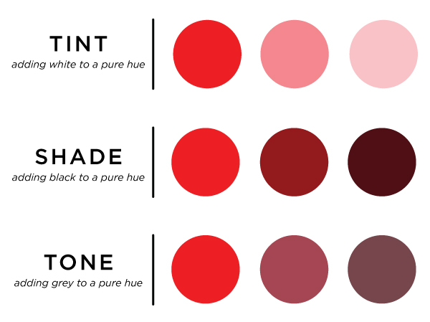
Colour Properties Saturation vs. Value
Hue + white = tint
(-saturation and + value)
Hue + black = shade
(-saturation and -value)
Hue + grey = tone
(-saturation and -value)

Slide 5
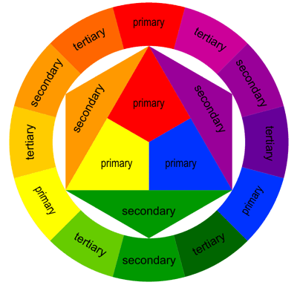
The Colour Wheel
The Colour Wheel is a principle that illustrates colour relationships
It organizes colours in a circle so you can visualize how they relate to each other
Primary colours are: red, yellow, blue (pillars of the colour wheel)
Gajanavale, Harshani. “Analogous Colors and Color Wheel” Medium.com www.uxplanet.org/analogous-colors-and-color-wheel-609a05b5b90e. Accessed May 2024

Slide 6
Secondary Colours
Two primary colours combined make a secondary colour.
Red + Yellow = Orange
Red + Blue= Violet
Blue + Yellow = Green

Slide 7
Tertiary Colours
A primary colour combined with a secondary colour results in a tertiary colour.
The six tertiary colours are:
red-orange
red-violet
blue-violet
blue-green
yellow-green
yellow-orange

Slide 8
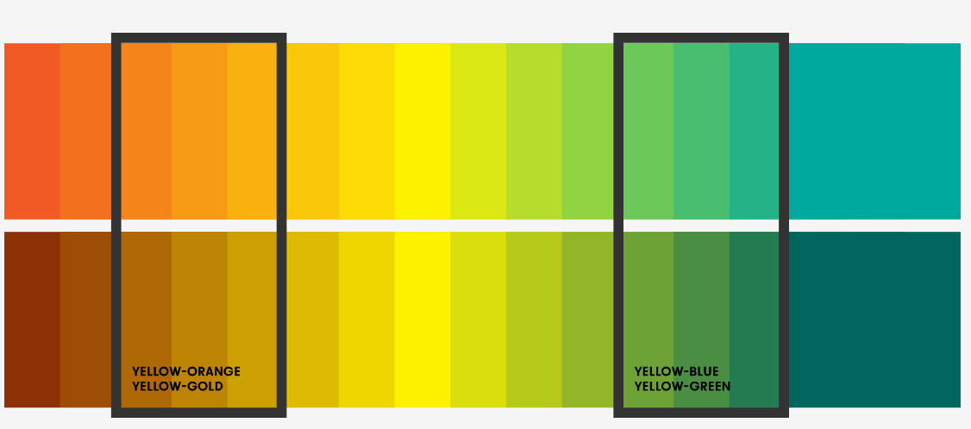
Tertiary Colours
An example of Yellow (primary) when mixed with a secondary (orange or green)
“Color yellow: Meaning and how to use it in branding.” Mojomox. https://mojomox.com/color-yellow. Accessed Aug 2024

Slide 9
Colour Harmonies
Use colour harmonies in a design to create a cohesive palette that supports a message.
Monochromatic – one colour
Analogous Side by side
Complementary Opposite
Triadic - 3 colours equal distance apart

Slide 10
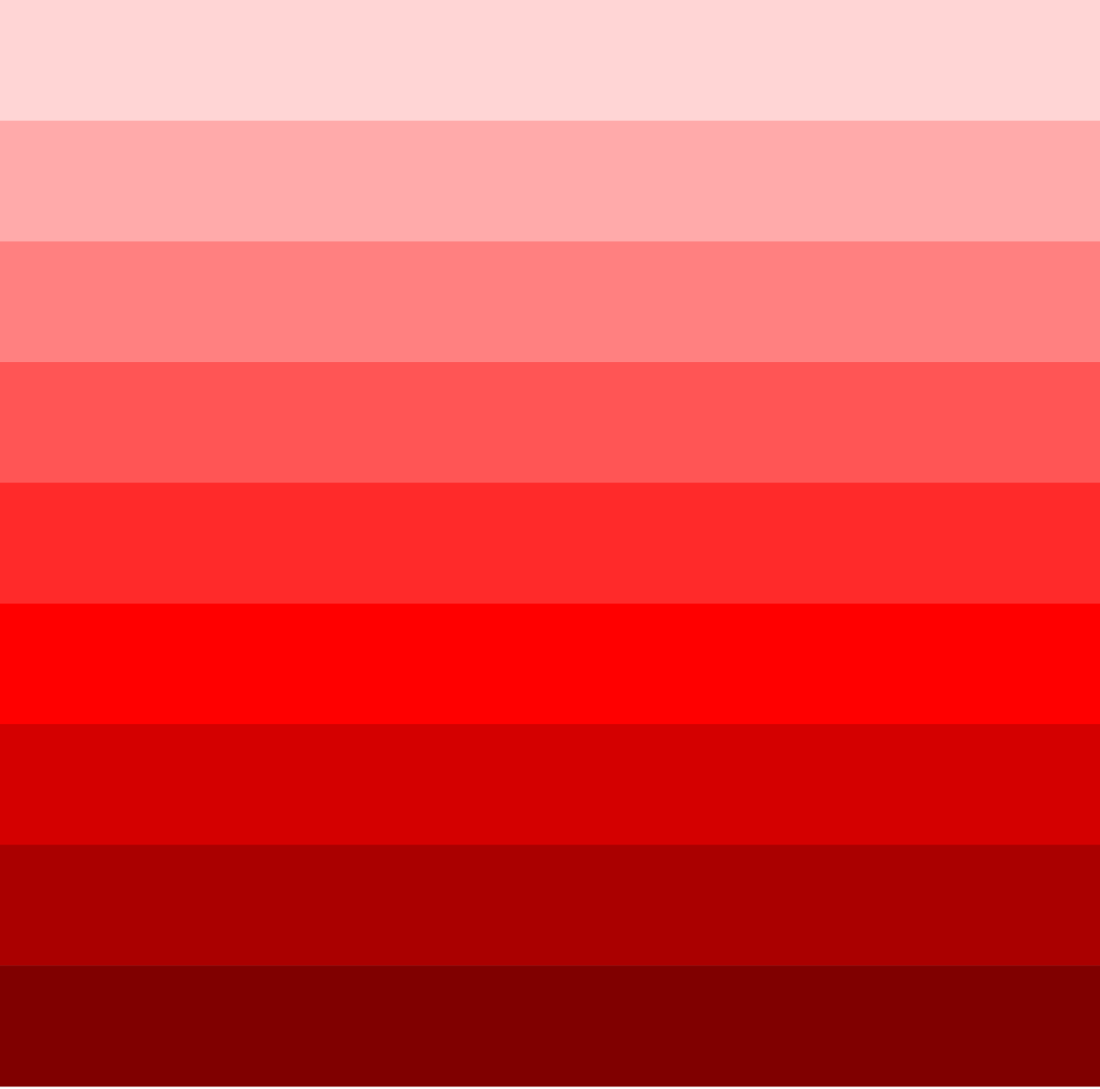
Monochromatic Palette
One hue
Hue can vary in value
Very harmonious, quiet,
restful & subtle

Slide 11

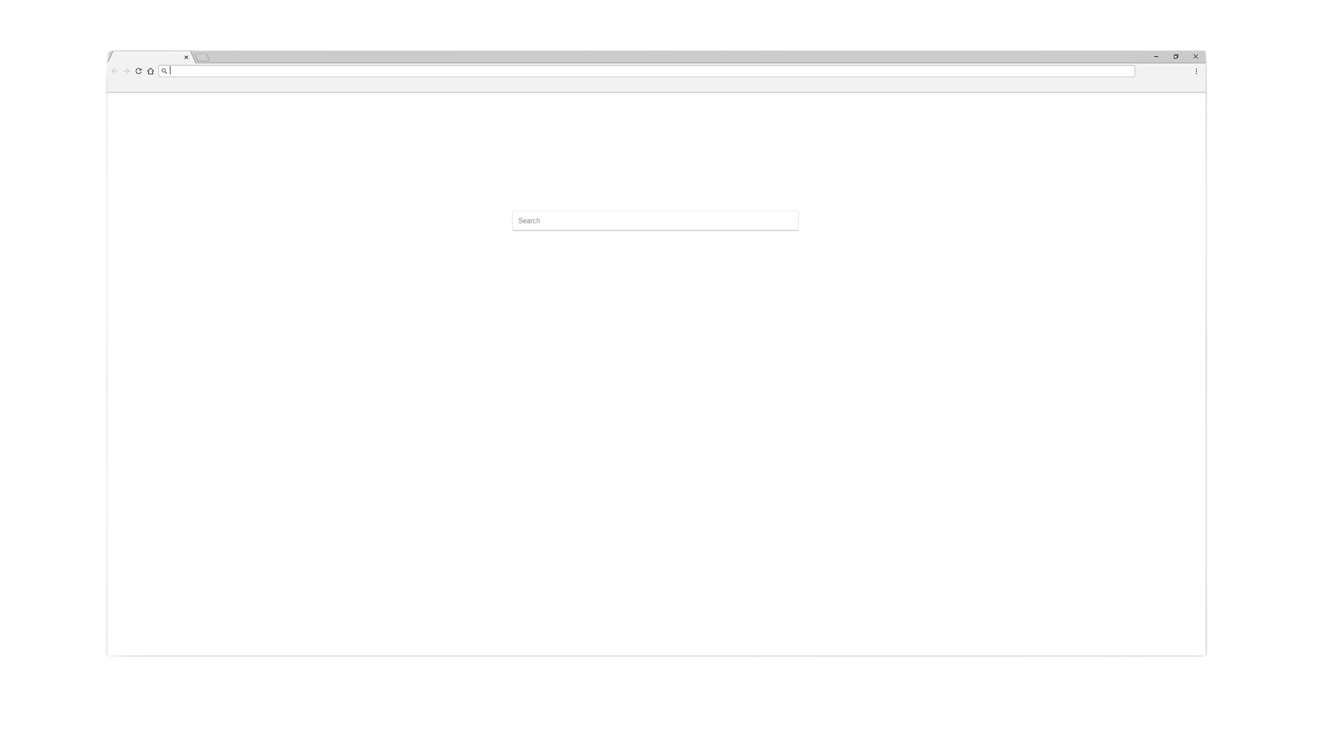
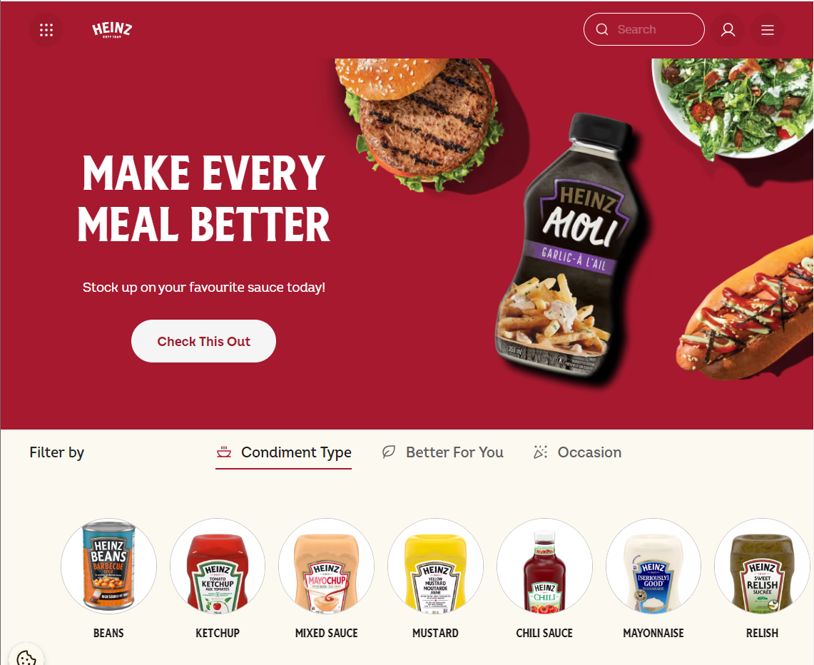
Examples of a monochromatic Palettes
Products - Heinz® Canada | Heinz. www.heinz.com/en-CA/products?condimentType%5B0%5D=heinz-ketchup.

Slide 12
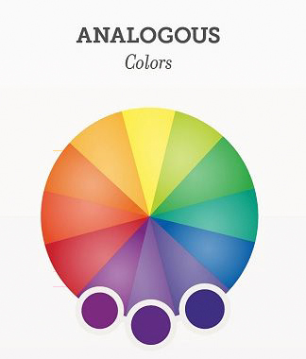
Analogous Palette
Several colours next to each other on the colour wheel
blue, blue-green, green
red, red-orange, orange, yellow
Harmonious feeling

Slide 13
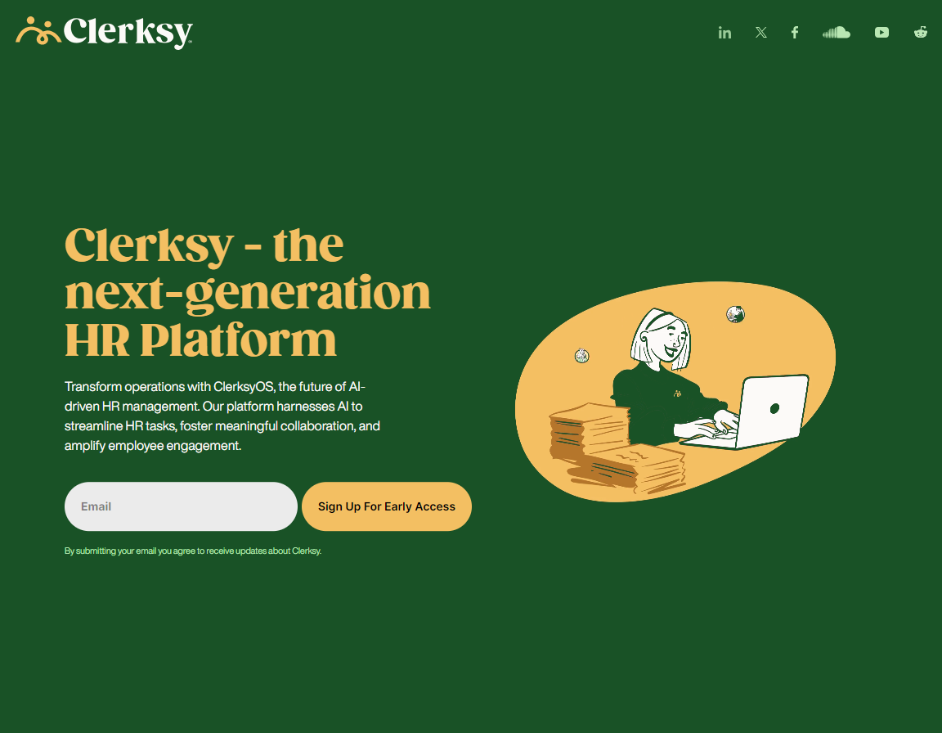

Examples of a complimentary Palette. Both Examples use green and orange with varying intensities for different results
Clerksy. clerksyhr.com/en.

Slide 14
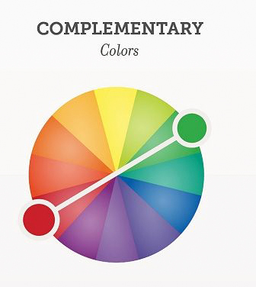
Complementary
Direct opposites in position & character
Produces excitement
Colours intensified when side
by side
Simultaneous contrast
Bold effect

Slide 15
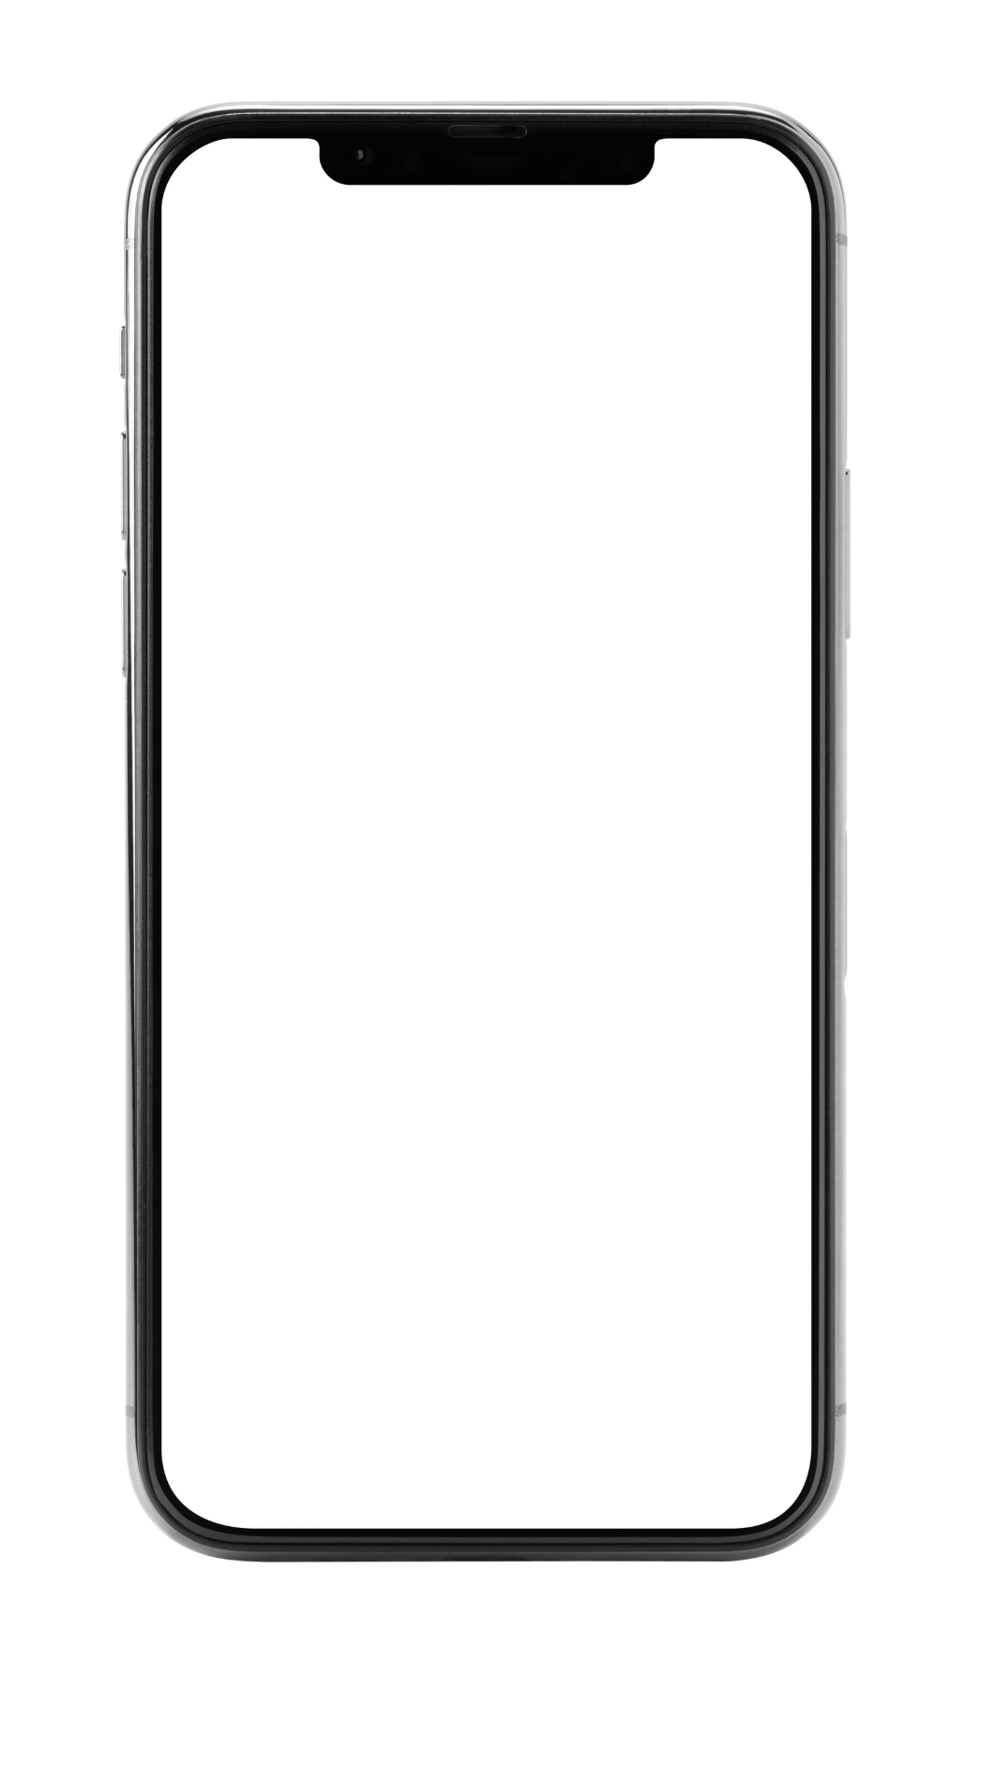

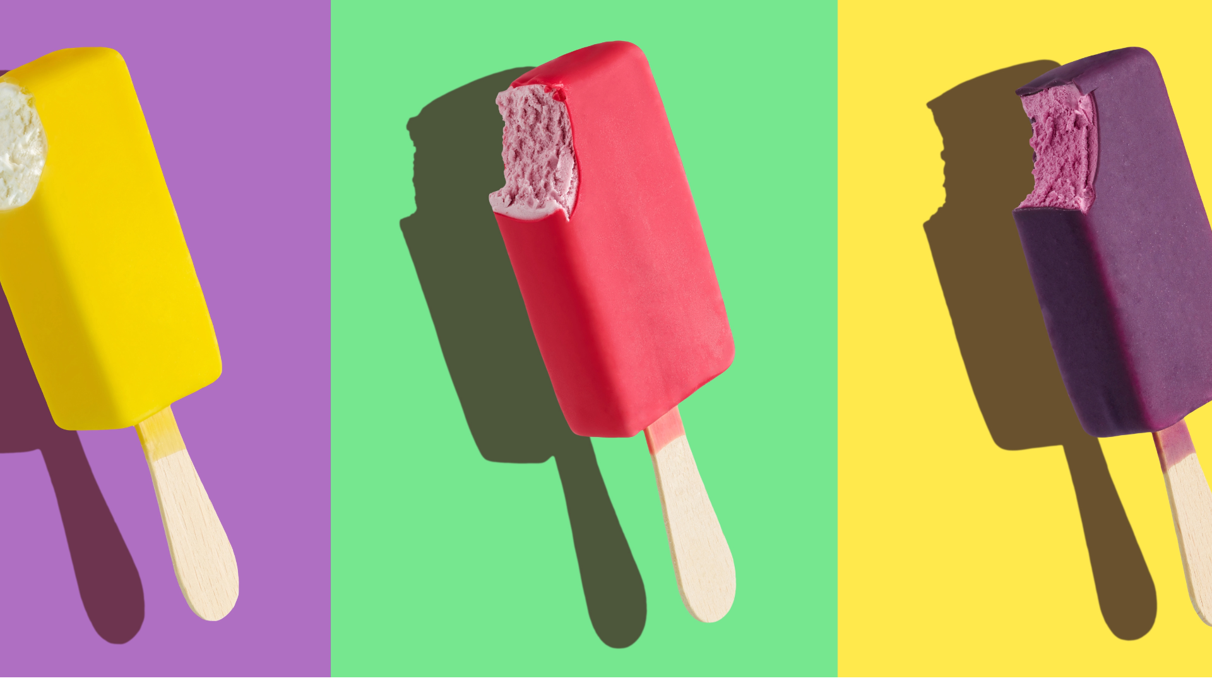
Examples of complementary Palettes
Welcome to LSU, a Top Research University | Baton Rouge, La. www.lsu.edu.

Slide 16
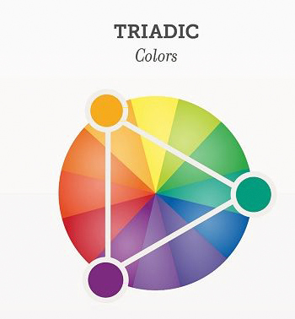
Triadic Palette
Three hues equally spaced
on the colour wheel
red, yellow, blue
orange, green, purple
Result is contrasting & lively

Slide 17
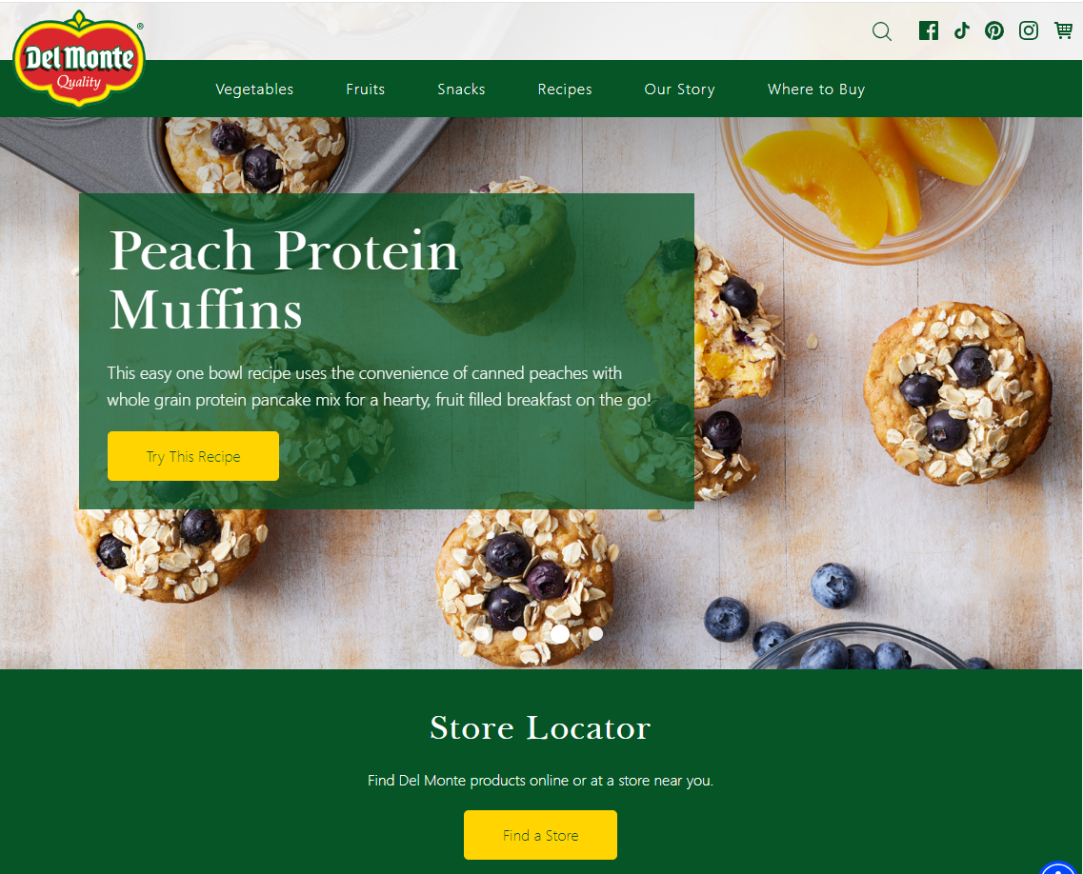
An example of a triadic Palette – Red, Green and Yellow
Del Monte. “Canned Fruits, Vegetables, and Veggie Snacks | Del Monte®.” Del Monte®, www.delmonte.com.

Slide 18
Colour Perception
The same colour can appear very different depending on its surroundings
Colors can appear to change size and intensity based on nearby colors
Can cause the viewer to see colours differently than intended
For example, colour areas tend to look darker and smaller against light backgrounds

Slide 19

Colour Perception

Slide 20

Colour Perception

Slide 21
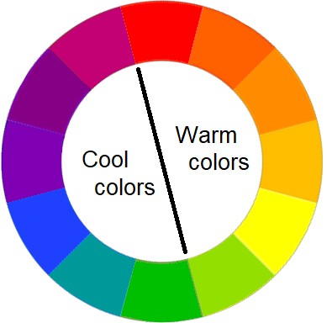
Colour Temperature
The temperature of a colour can affect how things are perceived
Warm colors – stimulate
Cool colors – calm and relax
White, black and gray considered to be neutral
Every Hue has a warm to cold spectrum

Slide 22
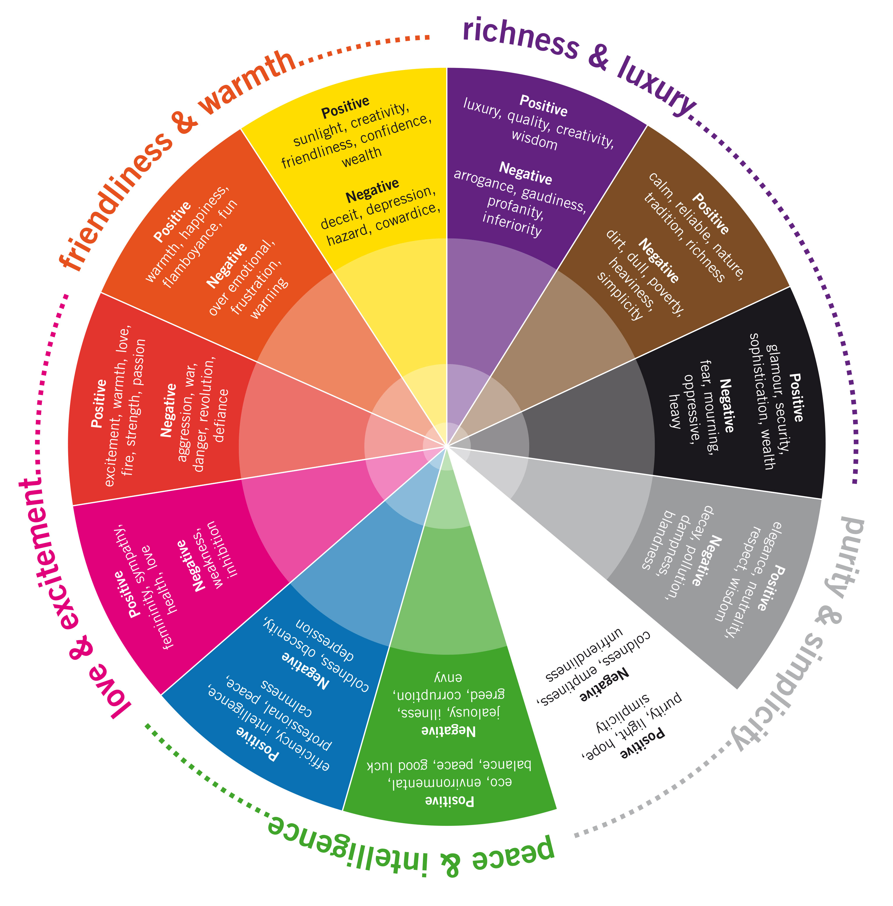



Colour Associations
Centeno, Carols “ Lose the colour Symbolism chart: The Unpresictabel Meaning of Color” medium.com/@carlitocenteno/lose-the-color-symbolism-chart-the-unpredictable-meanings-of-color-edc81db6541e. Accessed Aug 2024

Slide 23
6 Design Principles
The whole point of design is to grab and hold the attention of a viewer and to help them easily understand what is being communicated. These principals will help us create a visual vocabulary. In other words we will tell the viewer all about our culture, product, services etc. without telling them (we leave that up to the content writers!)
1. Hierarchy
2. White Space
3. Grouping
4. Placement and Division
5. Harmony
6. Alignment
Notes:
Before we go ahead and actually get started with the tools I wanted to look at some design principles. I specifically wanted to look at these to give you a handful of simple tools you can pull out of your back pocket and use if you're actually called on to do some design type work. these tools really provide a framework of tried and true layouts that will work. so instead of moving things around the page many times you can just dive in and use some of these principles in your designs
These principles are all really interrelated and you'll see multiple principles in one design for example a designer may use alignment and grouping to create hierarchy or may use white space and placement and Division to create alignment. we're going to use a lot of real world examples here and see why they work.
The whole point of your design is to try to get your viewer interested in your design, long enough to stop and look at it and take in the message.

Slide 24
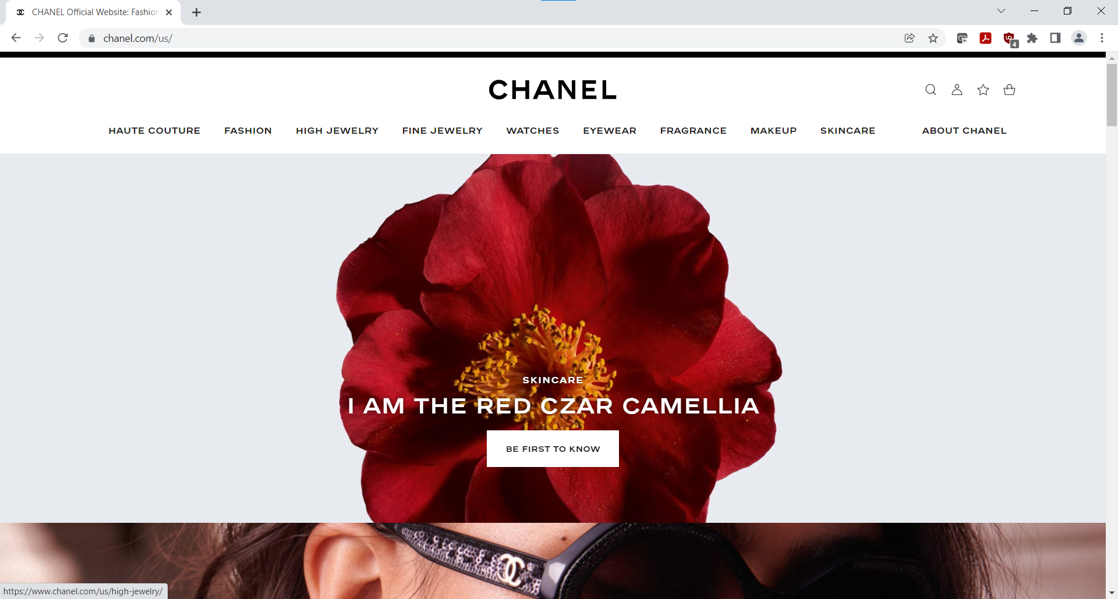
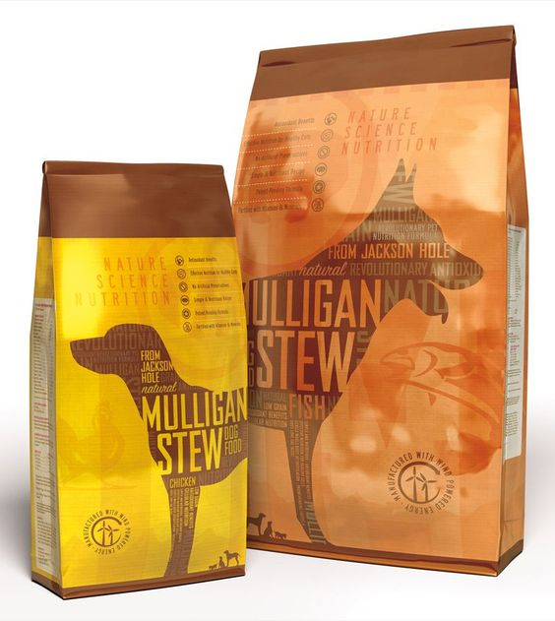
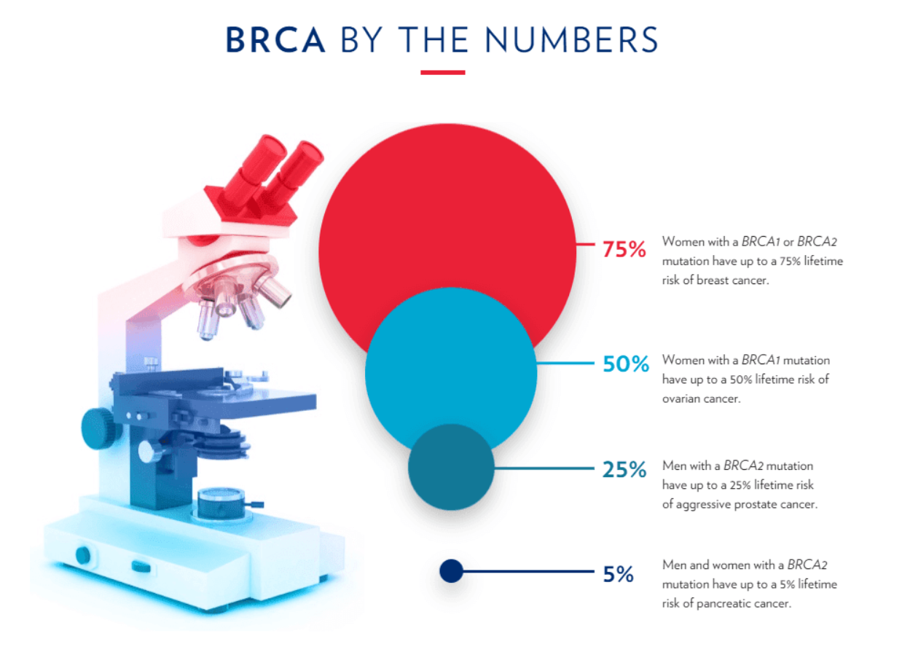
Hierarchy
Visual Hierarchy is used to rank design elements and influence the order your viewer sees the elements.
Clearly conveys what is important to look at and what is secondary therefore, It gives an easy path for the viewer’s eye to follow.
The viewer can digest the information more easily.
https://thedieline.com/mulligan-stew.html/
Accessed: Aug 2024
https://chanel.com
Accessed: March 2022
Basser Center for BRCA - 2020 Progress Report. www.basser.org/about-us/progress-report/2020.
https://www.basser.org/about-us/progress-report/2020/
Notes:
Let's start with hierarchy. So if I were to take 20 tennis balls and throw them all at you, how many do you think you'd catch, maybe a couple but miss most of them. if I were to take one tennis ball and throw it at you I think you would catch it. this is the whole principle behind hierarchy I want to give the viewer one prominent element to draw them into the ad. this element has to be more important than the others.
Let's look at a couple examples of what I mean so on the left hand side we have this beautiful packaging for For dog food what's the first thing that catches your eye? to me it's the outline shape of the dogs. That's my first tip-off this is dog food. secondly I'm drawn to the name of the product, mulligan stew and lastly I'm drawn to read the content on the bag. The secondary players on this bag are the shape of the bag and the colors and the actual finish of the bag which looks like some kind of foil. The colors are beautiful and natural and this foil finish adds a high-quality feel. So Hierarchy has been achieved here beautifully but it's also supported by the background player the colours and foil finish, Which are also telling me that this is a very high quality dog food. whether it is or not I don't know but that's definitely the statement the design gives
Let's look at a An example of Chanel's homepage. also a great job of hierarchy the first thing I'm drawn to is this red flower in the center of the page. In this particular design the hierarchy is supported by use of negative space so there's nothing around it and the nav is very plain. The text is centered right on top and centered on the flower and the call to action button is also centered directly underneath.
Our last example is taken from a report talking about the gene mutation brca that causes breast cancer. The designer has used hierarchy to demonstrate which kinds of the brca gene are most prevalent. They've created a hierarchy using color size and alignment.
You can see from these examples that the designer has clearly conveyed what's the most important thing to look at and what are the secondary Elements by doing this they've given the viewer an easy visual path To follow

Slide 25
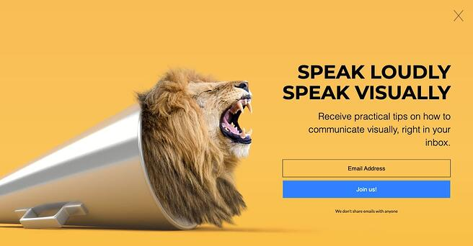
What makes a strong hierarchy?
Good use of white space
Harmony
- one font family
- link treatment
- alignment
Lion on megaphone
creates visual line to headline
Visme. “Create Presentations, Infographics, Design and Video | Visme.” Visme, www.visme.co.
Notes:
Let's look at one more example of what makes a strong hierarchy. in this last ad we can see excellent use of negative space. The lion inside of the megaphone is what our eyes are drawn to. it's a very interesting image, because it’s unusual and unexpected. It also creates a triangular shape that draws your eye to the headline.
After our eyes have been taken over to the the text, it also uses hierarchy the headline is the largest and the heaviest font followed by the body copy. the buttons are equally spaced and are centered underneath the headline. so the buttons really employ The principle of alignment too which really adds to the hierarchy.
Now let's look at example of weak hierarchy we can see in this ad there's no alignment no type Harmony some items are bolded some are not there's different use of fonts, there is little negative space there's poor contrast between the yellow text and the orange background and the grouping is very unclear I'm not sure Why there are two groups and what makes them different.

Slide 26
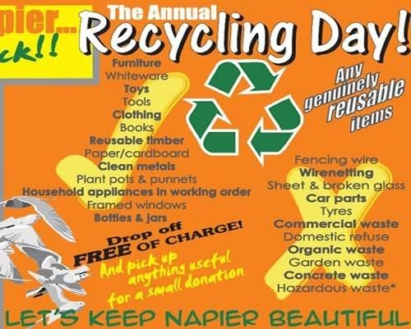
What makes a weak hierarchy?
no alignment
no harmony
- multiple items bolded
- too many fonts
No white space
unidentifiable visual elements
Poor colour contrast (yellow
text must be treated thoughtfully)
Unclear grouping
https://www.pinterest.ca/pin/788833690952656635/
Notes:
Now let's look at example of weak hierarchy we can see in this ad there's no alignment no type Harmony some items are bolded some are not there's different use of fonts, there is little negative space there's poor contrast between the yellow text and the orange background and the grouping is very unclear I'm not sure Why there are two groups and what makes them different.

Slide 27
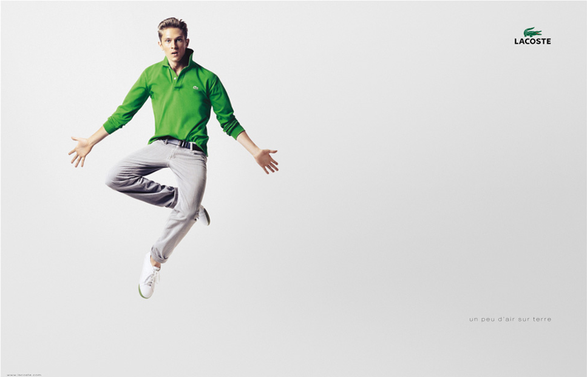
Negative Space (also called empty or white space)
Negative space gives the viewers eye a chance to rest and navigate the page easily. Too much content feels clutters and uninviting to read. White space can help create hierarchy or can make a communication more impactful
https://www.adforum.com/creative-work/ad/player/6682361/jumping-boy/lacoste
Notes:
Let's talk about the use of Negative space Negative space really gives the viewers a chance to rest their eyes to move around the page more easily. Too much content can often feel cluttered and uninviting to read. White space can also help create hierarchyand make a communication really impactfu.l if we look at this example from Lacoste it's just really this person on the left hand side of the ad and logo in the upper right hand side that's pretty much it but your eyes are immediately drawn to them and the color of the shirt their movement is very bold and eye-catching, it doesn't need anything else around it to get the point across

Slide 28
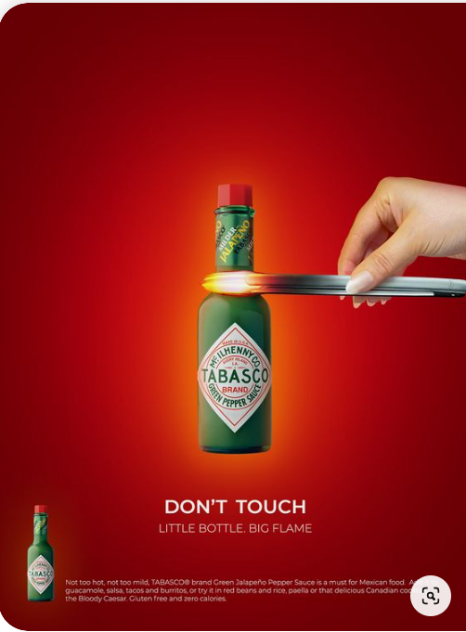
Negative Space
Negative space can be colours, gradients or patterns
https://pt.pinterest.com/pin/128915608075282662/
Notes:
If we move on to another example with Tabasco we can see negative space can also have pattern, gradient or colour In this example they've decided to use red and orange and a light yellow to create a gradient but it's still creating a negative space around the object and Therefore putting emphasis on this bottle. These colors were deliberately chosen to connotate hotness and resonate with the red color in the brand label. Like our hierarchy example with the lion this picture is unexpected, a pair of tongs holding a bottle of Tabasco sauce.
As a side note you can see how You can also see how Center alignment supports hierarchy, the most important parts of the message are in a column in the center of the page

Slide 29
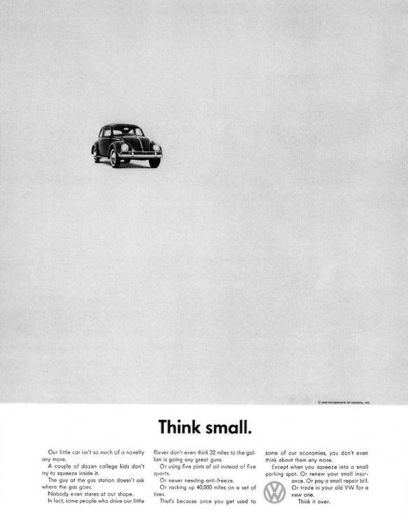
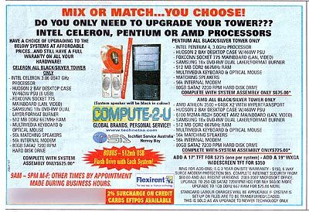
Examples of Negative Space
https://www.pinterest.it/pietroizzo/bad-graphic-design/
https://medium.com/theagency/the-ad-that-changed-advertising-18291a67488c
Notes:
the final example I want to show you is a classic example of negative space and a really bad example of negative space. on the right hand side this is a classic ad from Volkswagen I think it's from the 60s and you can see how they just use the old beetle in the upper left hand corner with absolutely nothing around it and a great headline to match. which really draws your attention in.
In the ad on the left you can see how cluttered it is there is no natural flow for our eyes to follow and the ad is just jam-packed with information. Unless I know this company I'm probably not going to take the time to read this ad it Makes their brand look so unprofessional that may not be the case at all they could be an amazing company but you don't get the feeling from this ad

Slide 30
Grouping/Proximity
Visually grouping “like” elements together helps the viewer to understand these element have something in common.
Creates relationship between Elements
Improved readability and navigation
Established hierarchy and emphasis
Reduces clutter
9 random dots
2 groups of dots – what do they have in common?
Notes:
if you look at the example on the top there's nine random dots I don't know what the relationship is or what the pattern is between these dots. In the bottom example we can see two groups of dots what Do the dots in each group have in common and what is different between The two groups. I think our brains work like this trying to drive meaning from things hat are grouped together and we can leverage this in our designs. we can create relationships between Elements bye grouping or proximity which will help improve readability and help again establish hierarchy and emphasis it also reduces clutter and invites the reader in.

Slide 31
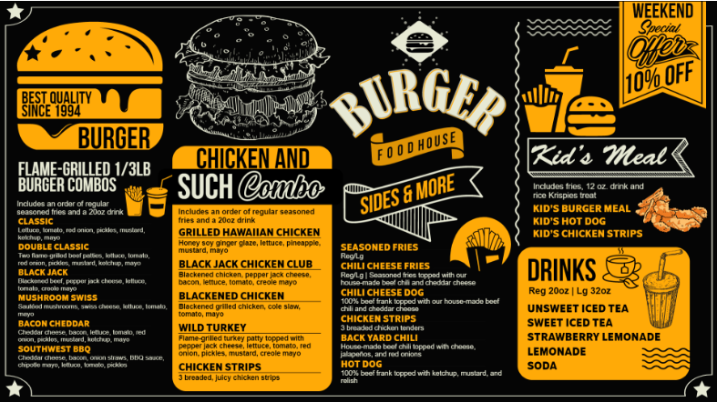
Grouping/Proximity
Dsmenu. “DSmenu - Digital Signage Menu Board.” Copyright(C) DSMenu 2023. All Rights Reserved., www.dsmenu.com/menuboard/Burger-Menu-Board-Design/horizontal/12/1.
Notes:
The next time you look at a menu notice like things are grouped with other like things that doesn't mean it has to be a static list the design can be still Dynamic and fun but We clearly can discern the groups within this menu.

Slide 32
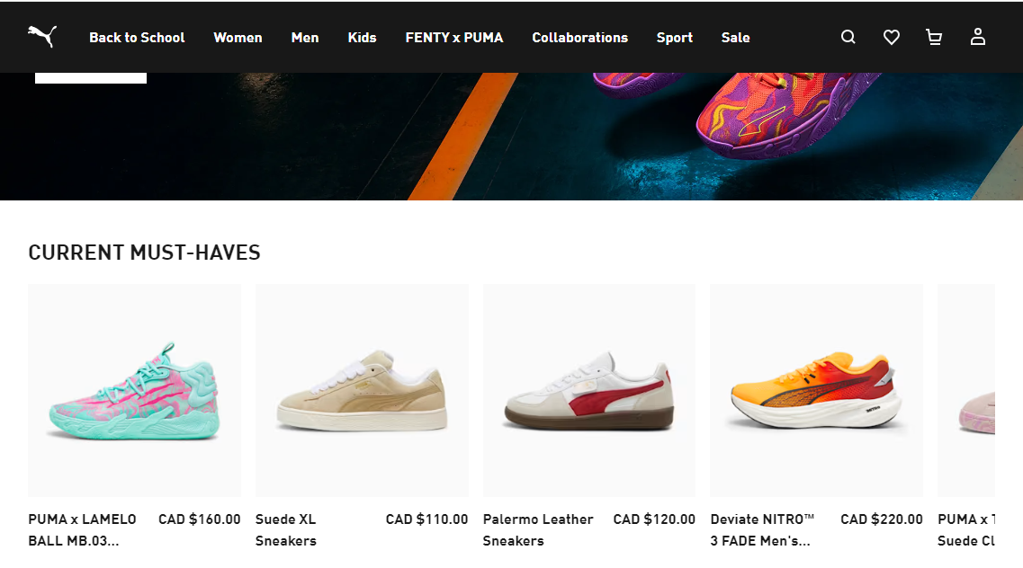
Spacing
When you design do not let spacing around elements just “happen” –
think about it!
Equal Spacing – Gives a sense of stability, but often feel static and bland.
Unequal Spacing – variety in spacing adds interest and makes a composition feel dynamic. It draws the viewer in (which is the whole point!)
PUMA.com | Forever Faster. ca.puma.com/ca/en?gad_source=1&gclid=Cj0KCQjw2ou2BhCCARIsANAwM2EuDP83xODm_UwfMVeQRPPRhfSgrcP6CkJSrHorgH91HpqNEra85yIaAunAEALw_wcB.

Slide 33
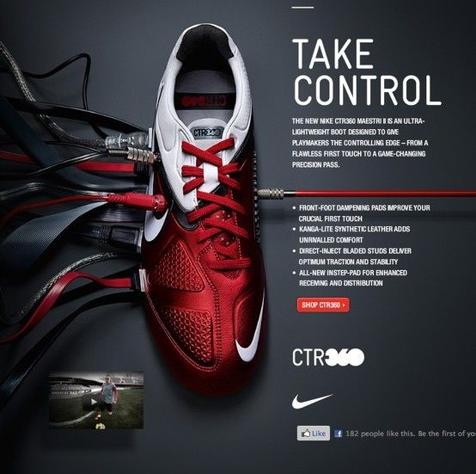
Spacing –
Unequal Spacing
https://kristenwiederhold.wordpress.com/2017/09/20/nike-take-control-ad/
Notes:
The next principal will look at is spacing so spacing really isn't considered by people who are not graphic designers things just go wherever they go. but it really is important to think about. Equal spacing gives a sense of stability but can often feel static and Bland but that is not always the case. In this example with Puma, it just makes the information very easy to digest so I have the navigation bar at the top that has equal spacing and these thumbnails of shoes That are equally spaced it brings a sense of Harmony and understandability to the design .
Unequal spacing can add a sense of the dynamic to the image it can really draw the viewer in let's look at a couple of examples You can see on this Nike ad the shoe
Creates a very strong boundary between the visual and the text, the shoe is not at the center of the picture it's More than half what way but it creates a dynamic and interesting look. Once again it's unexpected. If we look at the way the type is handled on this page you'll see spacings really important it chunks out information So we know what is the most important information and what is secondary information
You'll also notice on this ad the type spacing. there is a big gap between the first paragraph and the bullet points but the bullet points are spaced equally creating a group. When we use spacing within content it establishes the order and the importance, Headline, sub-head, body cop

Slide 34
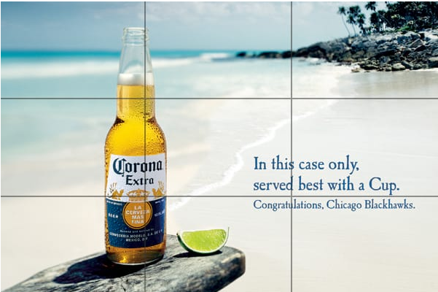
Spacing –
Rule of Thirds
Subject is positioned on a third grid of the picture
Katai, Robert. “A Marketers’S Guide to Composition in Visual Design.” ROBERT KATAI, 15 Mar. 2018, robertkatai.com/visual-design-composition.
Notes:
Going over now to another example of unequal spacing this is the rule of thirds basically Creating an invisible grid dividing an image up into thirds and putting the focus on one of the these grid Lines . the bottle of beer is actually situated directly along one of those grid line again creating I communication that is asymmetrical. Putting the focus on one of these grid lines is also a great way to deal with text, you can use the other 2/3 to deliver your written message

Slide 35

Alignment
An example of vertical alignment
Alignment creates relationships between elements. It can be used to create a sense of unity in a design
just like proximity alignment can signal elements “go together”
often designers use a grid system to strengthen alignment but not always!
https://www.businessinsider.com/25-nike-ads-that-shaped-the-brands-history-2013-8
Notes:
Next we'll move on to alignment so alignment creates relationships between elements it can be used to create a sense of unity in the design just like proximity alignment can signal elements that go together.
Often designers will use a grid system to strengthen alignment but not always the case. we can see on this Nike ad the text is right underneath the eyes it's also vertically right in the center of the ad so very strong Center or hozontonal alignment.
The eyes are at the center of this ad so placing text right underneath the eyes was a great c

Slide 36
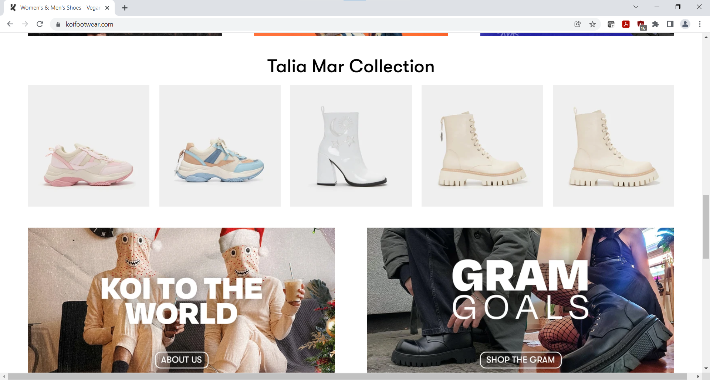
An example of vertical and horizontal alignment. This also also uses equal spacing to group like elements
Notes:
In this example you can see how equal spacing pairs with alignments to create a group. We can see in this example how everything is aligned vertically and horizontally the small thumbnails are aligned to the two larger images beneath. When we look at this we know we are looking at two different pieces of information
I know this may seem obvious but it's only obvious because we've all seen this a hundred times and intuitively understood these things are separate

Slide 37
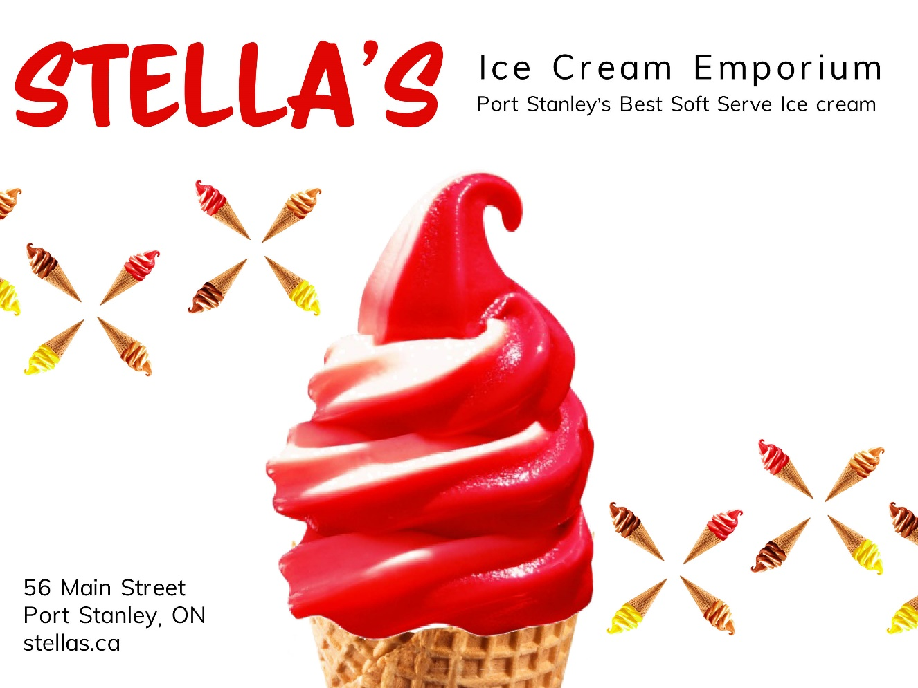
Harmony
Visually harmony creates agreement between elements. You can create harmony through repetition of elements like shapes, colour, patterns
Notes:
The last design principle I wanted to talk about is harmony so Harmony is used within all the other principles we've just talked about visual Harmony creates agreement between an element you can create Harmony through repetition of elements like shapes colors pattern or text so let's look at a few examples right here we can see an example of using a pattern in the background to create Harmony also color the color on the cone and the color in the text is the same

Slide 38

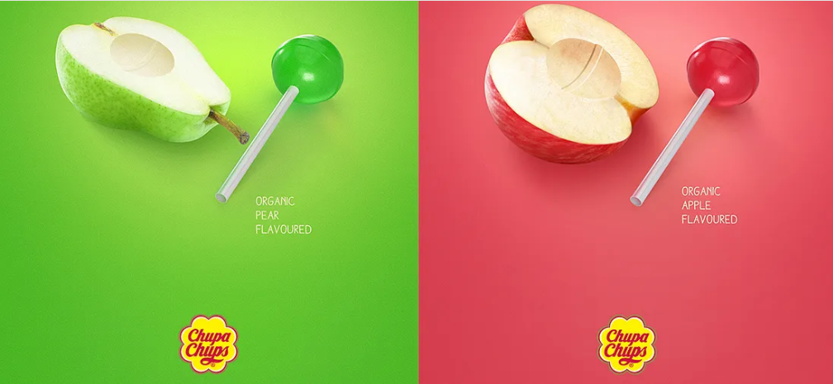
Harmony by repetition and repeating shapes (background)
Harmony by repetition of colour and shape
in the wander years. “Dr Martens Collection | How to Style Docs.” YouTube, 24 Mar. 2019, www.youtube.com/watch?v=e79js7lAy00.
https://medium.com/sviiter-blog/famous-logos-part-vii-chupa-chups-c7051288136b
Notes:
here we have a couple more examples. Harmony is created by the repetition of a shape namely the shoes, There is also Harmony created because each of these shoes are upside down. the background in this ad is also cut equally on an angle again creating harmony. if we look at the chupaad we can again see Harmony created by the use of a gradient the shape and the placement of the lollipops and the fruit.

Slide 39
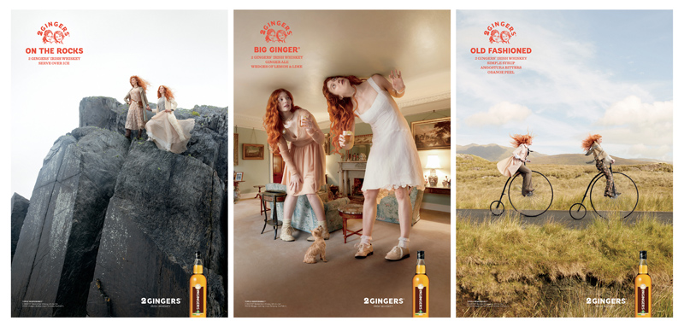
Putting it all Together
Unequal spacing
Centre Alignment
Blank Space
Image source: https://www.visme.co/
Right Alignment
Proximity
Right Alignment
Notes:
So let's just look at three more examples that employ many of the principles we were just talking about so this is a whiskey company called two Gingers and they have some fantastic ads going from left to right you can see the use of Blank Space you can see the use of proximity in all of these ads the two models are together. In the middle ad we can see the use of unequal spacing and in the last add we see Center alignment we also see in each of the odds that the actual product shot, the bottle of whiskey is firmly right aligned with the left hand of the subject. From a conceptual standpoint these ads are really interesting but they also employ a lot of the standard design principles.

Slide 40
Photoshop 1

Slide 41
Lesson Objectives
Start Adobe Photoshop CC
Learn how to open and save an image
Examine the Photoshop window
Change appearance of your Workspace
Close a file and exit Photoshop

Slide 42
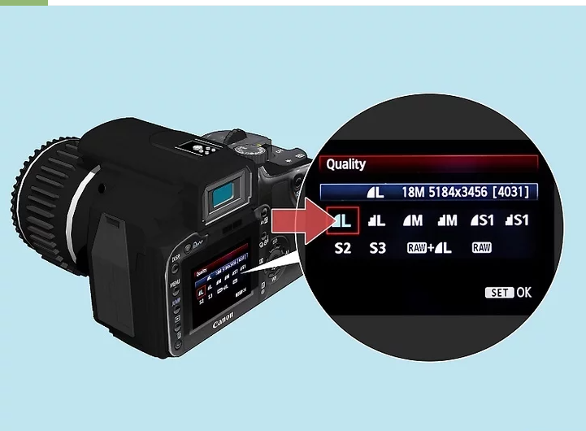
Understanding Pixel (Raster) images
An image is made up of units of information called pixels
In Photoshop, you can add, delete, or modify individual pixels or groups of pixels
Images in Photoshop are Resolution-Dependent (the capture format determines the size of the working formats. You cannot create a high-resolution composition from low-quality images)
De Jager, Karen. “How to Take High Resolution Photos: Settings and More.” wikiHow, 1 Oct. 2023, www.wikihow.com/Take-High-Resolution-Photos.

Slide 43

Understanding Pixel (Raster) images
Lower quality
Higher quality
Lower resolution
(72DPI)
Banded colours
Fuzzy or pixelated image
Small file size
Higher resolution
(300 DPI)
Richer, Truer colour
Crips lines
Larger file size
Smartpress. “PPI, DPI & Image Resolution.” Support, 10 July 2024, smartpress.com/support/printing-basics/image-resolution.

Slide 44
File Formats
Capture formats
JPG – Widely used, small size, quality can range depending on level of compression
RAW – Contains all of data captured by camera; less compression and better quality
Working formats (for editing)
PSD and Tiff – save all photoshop options (masks, adjustments, layers etc.)
Output formats (for sharing but not editing – flattened file)
JPEG – smaller size, widely used
PNG – Transparency support, web graphics
GIF – often used for making simple animation (eg. Ad banner)
PDF – Distribute secure document (not flattened when opened in Illustrator)

Slide 45
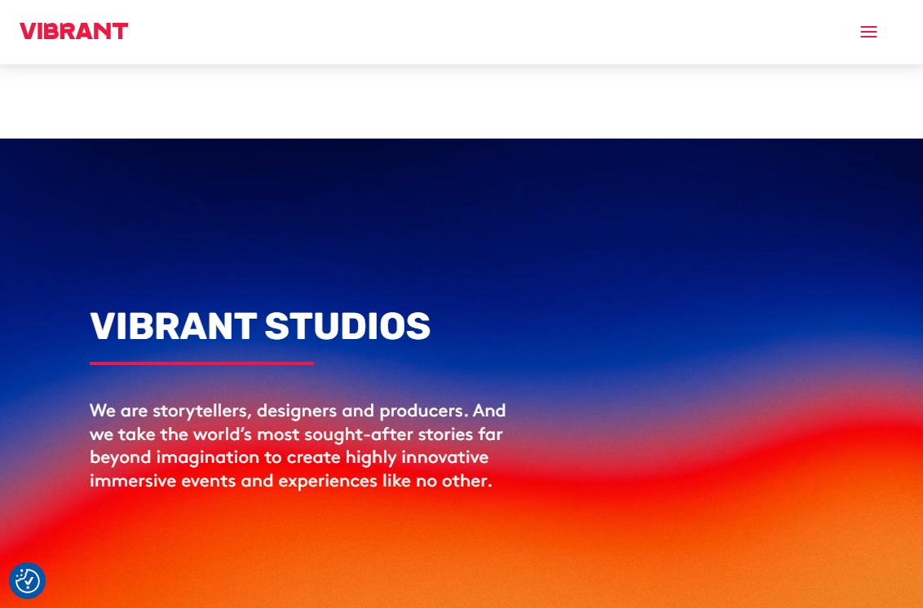
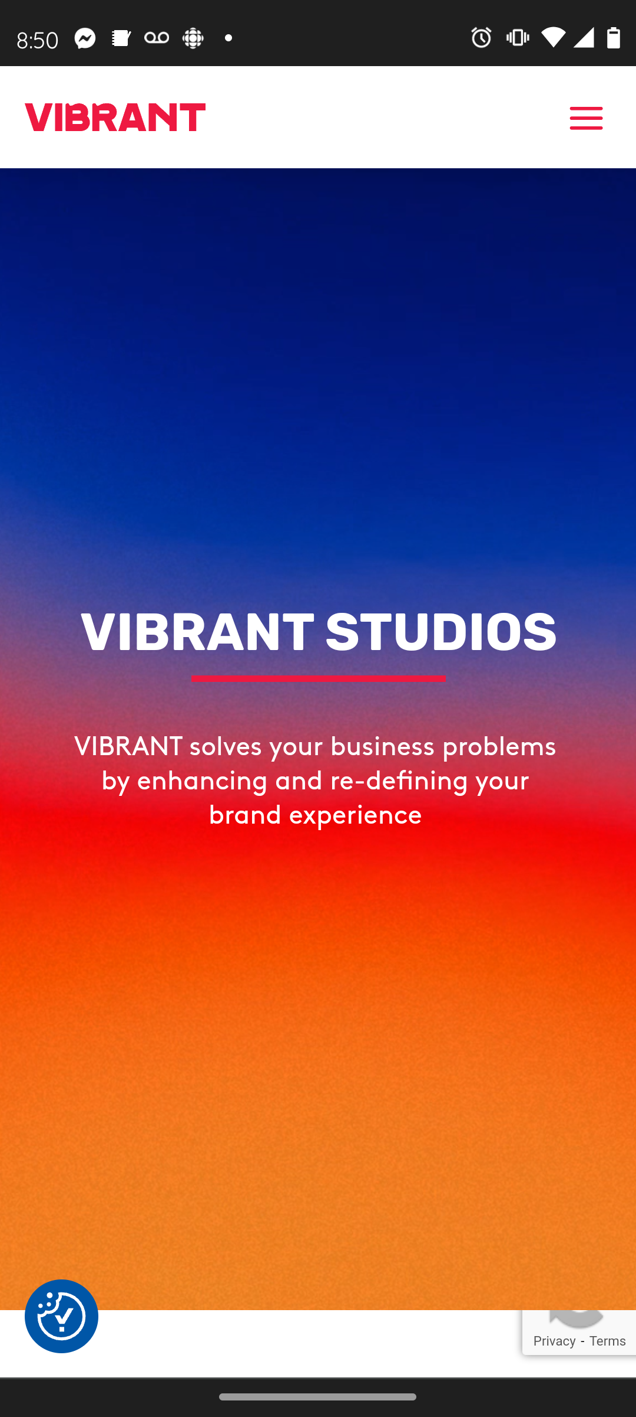
Understanding Colour Spaces
Different devices display colour differently
Some devices have more colours to choose from and some have less
Devices also have different colours. A yellow on your laptop screen will not be the same yellow as on your phone
Notes:
Let's talk about a couple concepts with color.Devices willl display color differently so if you ever notice you're looking at the same website on your phone versus your laptop those colours may look very different depending on the quality of the screen. typically a higher quality screen will have a wider range of colors then a lower quality screen. The Entire range of colors is referred to as a gamut

Slide 46
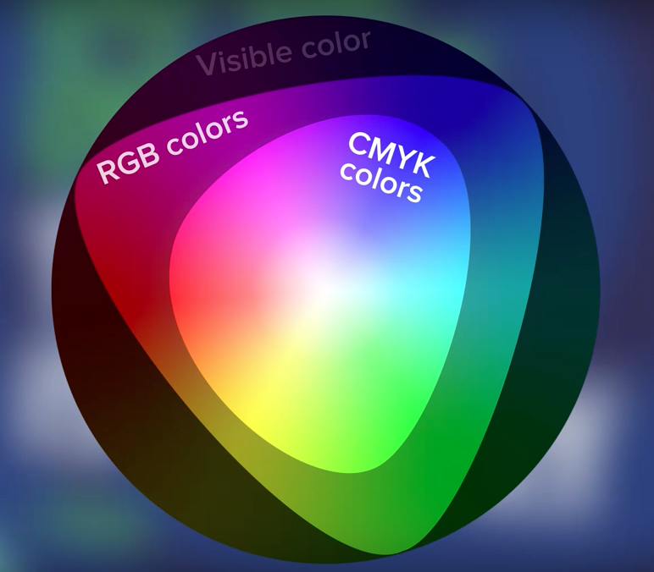
RGB Colour Gamut
The two main color models we’ll use:
RGB Mode or CMYK Mode
Decide which colour mode you will used based on where you will use the final image – Print (CMYK) or Screen (RGB)
  RGB has a wider gamut than CMYK, which means that not all RGB colors can be reproduced in CMYK (i.e. not all colors on screen can be reproduced in printed ink). The difference in gamut is most noticeable when dealing with very bright, vibrant colors.
  Most higher quality screens can display all of the RGB colour gamut
Pejanovic, Filip, “RGB vs. CMYK Guide to Color Spaces”. Printful. https://www.printful.com/ca/blog/rgb-vs-cmyk-guide-to-color-systems, Jun 6, 2023
Notes:
So let's keep that in mind as we look at a different concept you can see on the diagram to the
right we have three shapes visible color RGB color and CMYK color so the visible colors are all colors that the human eye can see. RGB is the next largest size and it represents colors that can be shown in a digital format CMYK colors which is even smaller Represents the color gamut available to us in print colors. So there are many more color choices available in an RGB color space, Again a higher quality screen will be able to show more of this RGB color gamut.
Keeping that in mind the color mode that most screens use is called the RGB mode, or red green blue. If we look at this diagram we can see three different shapes outermost ring is visible colors then a triangle shape called RGB colors and then an inner shape called CMYK colors. So obviously visible colors would be all colors that are visible to the human. RGB or red green blue colors

Slide 47
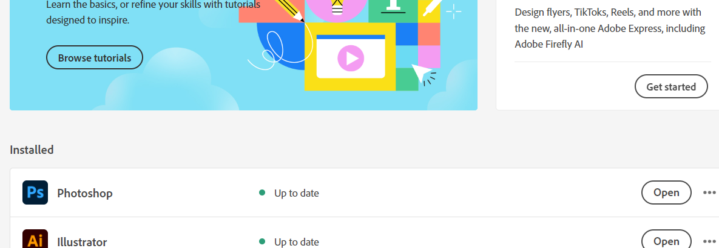
Opening Photoshop
Once you have downloaded the Creative Cloud Desktop App.
Install Photoshop
Open Photoshop

Slide 48
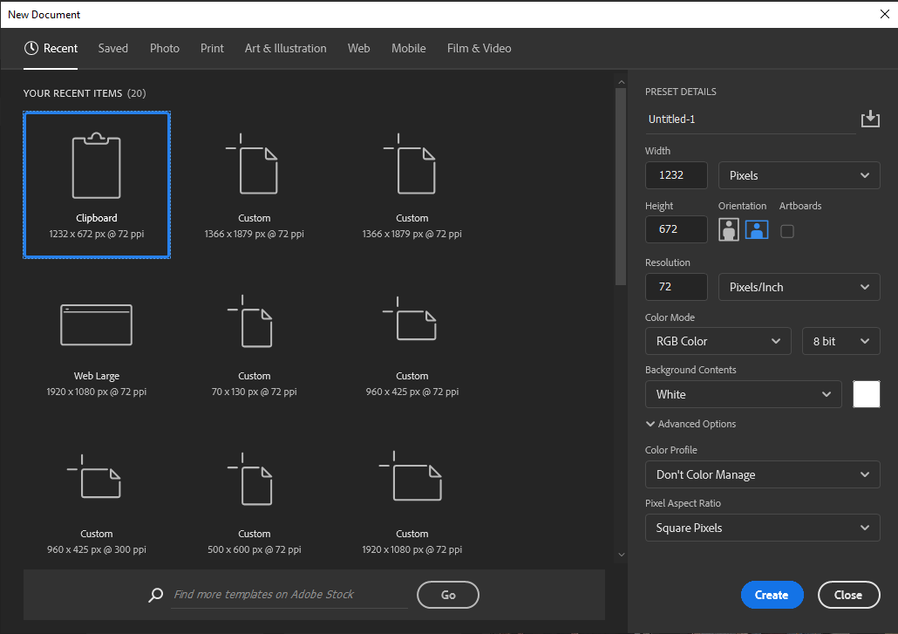
Creating a New File
Click File>New on the Menu bar
Enter a width in the Width text box or choose preset
Set orientation, Resolution, Colour mode and background contents

Slide 49
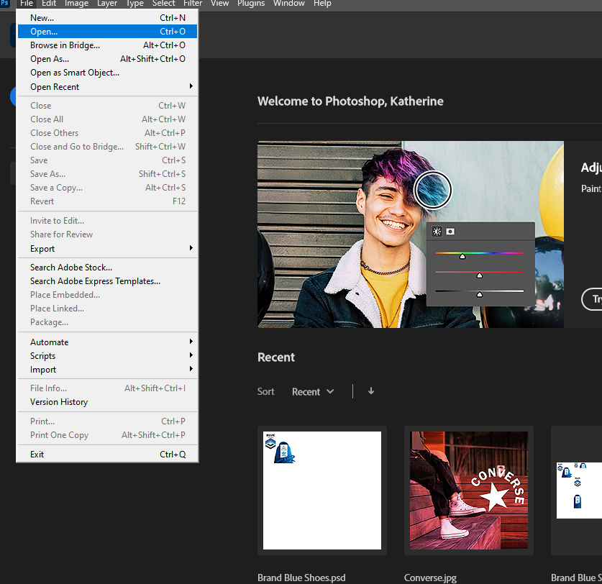
Opening an Existing File
Use the File menu to open a file:
Click File (Menu bar) > Open
Click the Look in or From list arrow
Navigate to the location of the file
Click the filename, then click Open

Slide 50
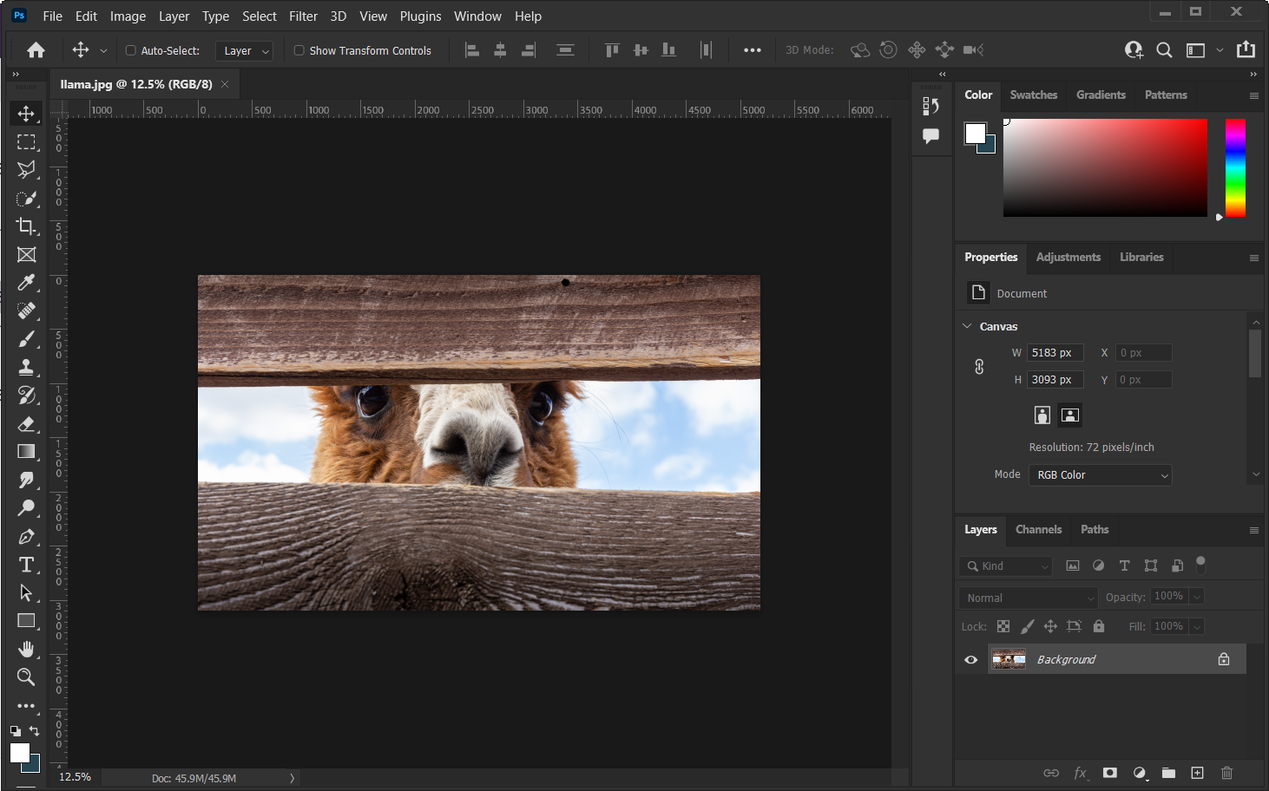
The Photoshop Workspace
Options bar
Application bar
Tools Bar
Workspace
Panels
Contextual Task Bar
Status bar
Notes:
so let's have a look around this workspace we could see at the very top we have the options bar. The application bar houses many of the tools contained in other parts of this interface and some additional tools too so we'll be using this drop-down menu from time to time
Right underneath that we have the options bar this is a context dependent menu so you'll notice it'll continue to change depending what layer we're working on or depending what tool we are working with
Coming down on the left hand side we have the actual toolbar itself so here We have several simple tools that are Standalone one click tools like the burn tool scrub tool crop tool., zoom tool
But we also have tools here that are supported by further modifiers in the panels which will be Like all of these selection tools The type tool The shape tool To name a few
Now going over to the right hand side we have our panels. Many of these panels support further modifiers to the tools we were just talking about so for example, If I am using the type tool I have a panel that further modifies type not just font but But font weight and other graphic design tools like letting kerning tracking. Will be going into what those things mean shortly. Some panels are completely independent of a tool and work on their own We can find a full list of panel options From the window drop down menu.
Next up we can actually see the artboard and pasteboard in the center of the image You can drag layers on and off the artboard To the PAste board and bring them move later if you need
them
The last part of this interface I want to talk about is the contextual taskbar, which is a very new addition to photoshop. Adobe has been trying to make Photoshop less intimidating and more user friendly. When you have an element selected the contextual taskbar Display the most common tools used with that element. for example if I add a shape The contextual taskbar will show me options associated with a shape Which is Which is fill, l stroke color and weight or thickness Corner radius Etc. When I choose a type element it will show me font, Font size and color , alignment Etc. these are not all the options available with these elements but they're probably the most common and most used.

Slide 51
The Photoshop Workspace
The Workspace includes the following elements:
Document Window - displays the file you’re working on. Document windows can be tabbed and, in certain cases, grouped and docked. Application Bar - contains menus
Tools Bar - contains tools for creating and editing images, artwork, page elements, and so on. Related tools are grouped.
Status bar – displays the size of the file your working on and the current zoom level
Panels - Helps you monitor and modify your work. Panels can be grouped, stacked, or docked.
Options bar - Displays options for the currently selected tool.
Contextual Task Bar - Provides common tools, actions and next steps based on the files you are working on.

Slide 52
Using Panels
Use panels to modify images
Find all panels under View
Adobe groups multiple panels that go together (e.g colour, swatches, gradients, patterns)
Panels can be separated and moved around the workspace
Each panel contains an options button
and a menu

Slide 53
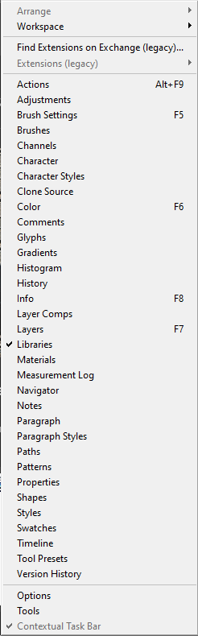
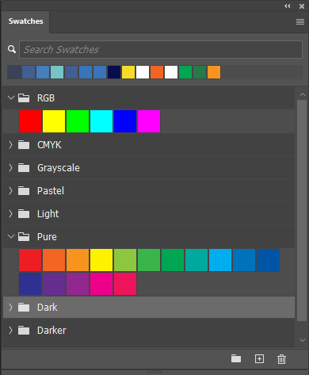
Using Panels
Find all panels under the view menu
The open swatches panel

Slide 54
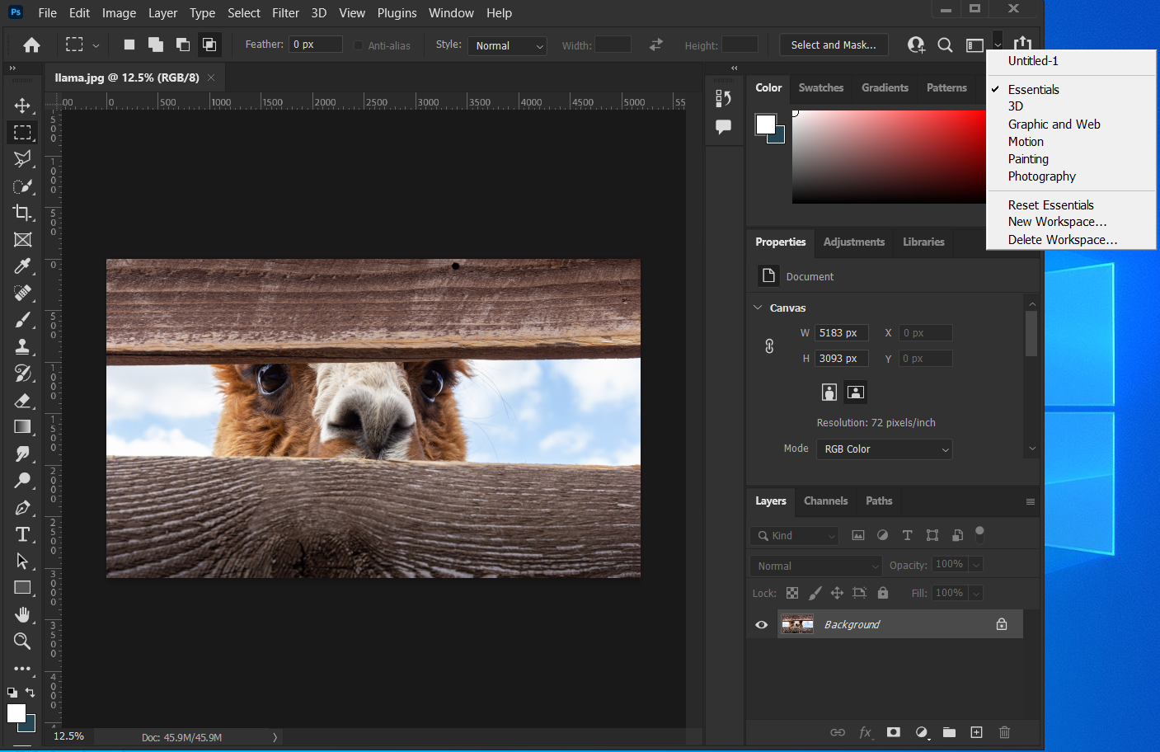
Customizing the Workspace
Choose a pre-set workspace to suit they type of project
When panels get disorganized click “Reset_panelname”

Slide 55
Customizing the Workspace
Customize the workspace by opening panels from window menu panels to suit your working style
To save a custom workspace:
Click the workspace switcher on the Menu bar, click New Workspace, type a name, then click Save or choose a preset workspace

Slide 56
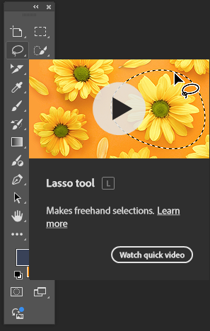
The Tool Bar
Use tools in Photoshop to perform actions
(e.g., zoom, type text, etc.)
Point to a tool to view a ScreenTip that provides the name or function of the tool
The options bar is context dependent, so it will change options as you change tools
Hover over a tool to see tool tip

Slide 57

The Tool Bar
The options bar is context dependent, so it will change options as you change tools

Slide 58
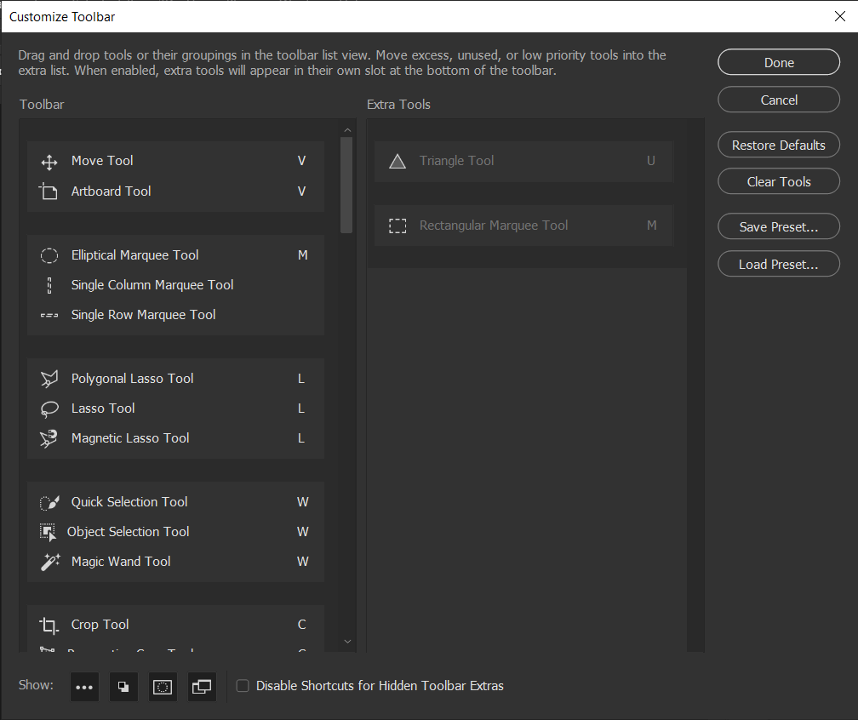
Using Tools
Add, subtract or move tools using the customize toolbar option
Access Customize toolbar by clicking “…” at the bottom of the toolbar

Slide 59

Using the Type Tool
Whenever we want to add any sort of text to a document, we use Photoshop’s Type Tool in the Tools panel. You can also select the Type Tool by pressing the letter T on your keyboard
Notice the Options Panel when you select the Type Tool to modify font size, type, color, etc.

Slide 60

The Move Tool
The move tool allows you to move a selection or entire layer by dragging it with your mouse or using your keyboard arrows keys. The move tool is located at the top right of the Photoshop Toolbox.
When the move tool is selected, click and drag anywhere in the image. By default, if an area is selected the selection will be moved, otherwise the whole layer will be moved. See the options bar for more options.

Slide 61
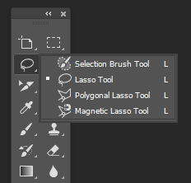
Using Tool Shortcut Keys
Click the tool’s shortcut key (e.g., T for Type tool)
Continue to click the shortcut key+ [Shift] to cycle through a tool’s hidden tools
Or long press on the triangle in the bottom right-hand corner to see all options
Hover over tool for quick tutorial

Slide 62
Using the Save As Command
Use the Save As command to save an existing file with a new filename:
Click File on the Menu bar, then click Save As
Navigate to the location where you want to save the file
Type a new filename, then click Save

Slide 63
Close a File and Exit Photoshop
Close the file:
Click File on the Menu bar, click Close, then click Yes (Win) or Save (Mac)
Exit Photoshop:
Click File on the Menu bar, then click Exit (Win)
Click Photoshop on the Menu bar, then click Quit (Mac)

