Slide 1
Module 2
Photoshop 2
INTERNET APPLICATIONS & WEB DEVELOPMENT
Notes:
All of these slides can be used as is or modified.

Slide 2
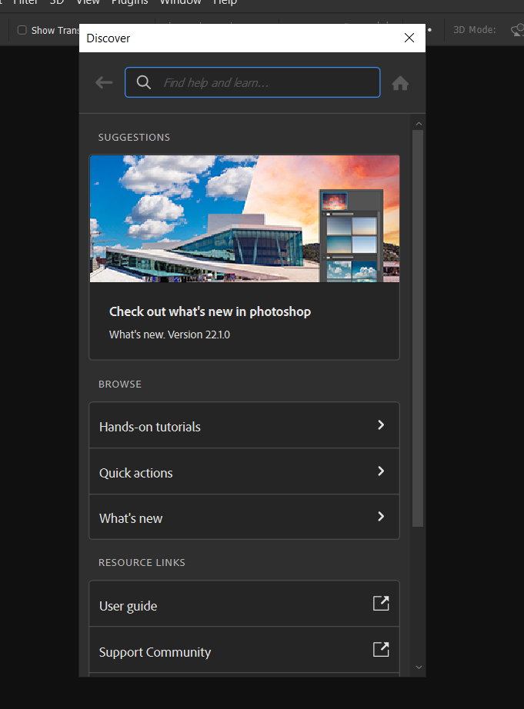
Learn about Photoshop by
Using Help
Help > Photoshop Help
Photoshop Discover dialogue box opens
You can click a tutorial, quick action or connect to guides or support community
Enter a keyword in the Search text box

Slide 3
Contextual Task Bar
The Contextual Task Bar in Adobe Photoshop is a dynamic interface element that appears at the top of the workspace. It offers quick access to settings and options that are directly related to the tool or task you are currently working on.
Here’s what you need to know:
Tool-Specific Controls: When you select a tool (like the Brush or Marquee tool), the Contextual Task Bar updates to show options relevant to that tool. For instance, with the Brush tool, you can adjust size, hardness, and opacity right from this bar.
Layer and Adjustment Options: The bar also provides quick access to controls for layers and adjustments depending on what is currently active in your project. If you’re editing text, for example, it will display text formatting options like font style and size.
Efficiency Boost: By consolidating relevant controls in one place, the Contextual Task Bar helps streamline your workflow. It minimizes the need to navigate through various menus or panels, allowing you to make adjustments more efficiently.

Slide 4
History Panel and Undo Command
The History panel contains a record of each task completed in an image
The record of an event is called a state
The History panel displays up to 1000 states, but will slow down your performance
  Photoshop > Preferences > Performance
  To Undo you last command Edit>unmove or Ctrl/Cmd + Z

Slide 5
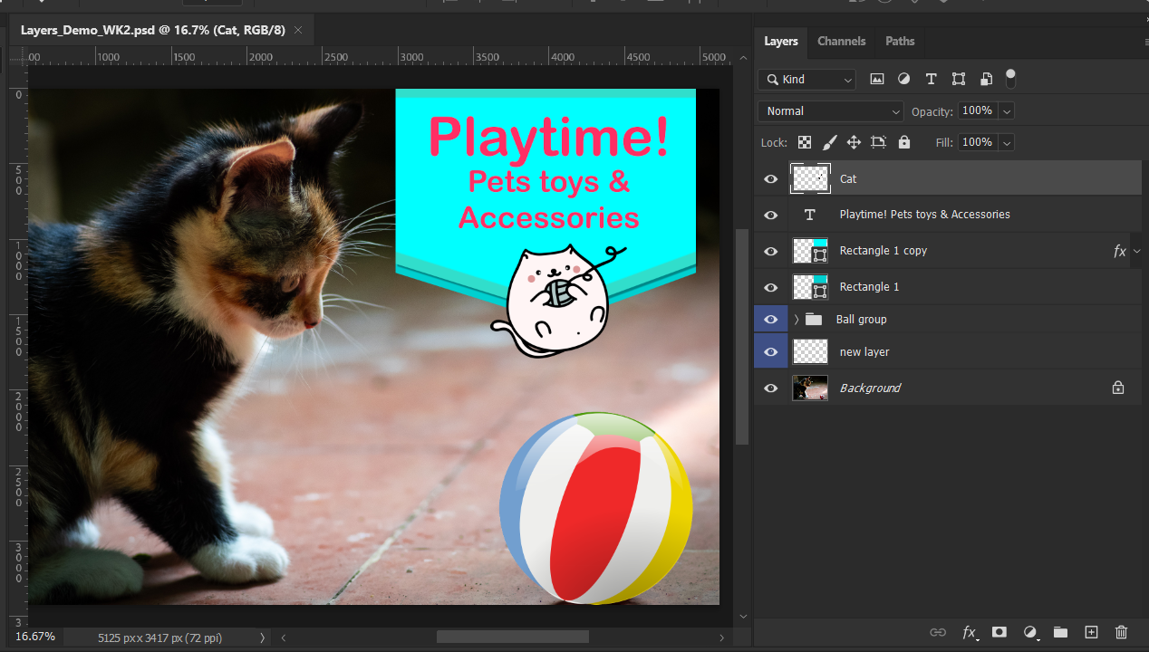
Understanding Layers
Layers allow you to control individual elements in a photoshop document
Individual layers
Layers panel

Slide 6
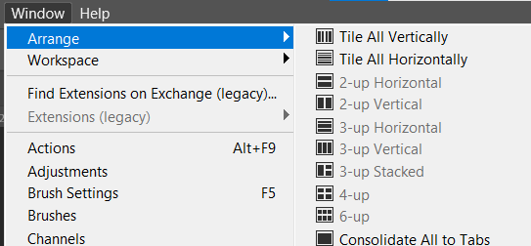
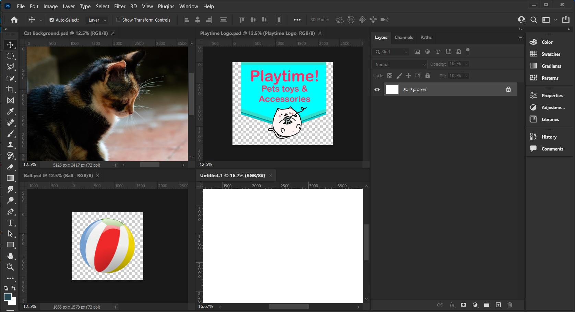
Tiling multiple images
Arrange open documents into vertical or horizontal tiles
Window>Arrange and choose tile configuration

Slide 7
Target an open document by clicking on it
Untitled – 1 document is targeted because the name is highlighted

Slide 8
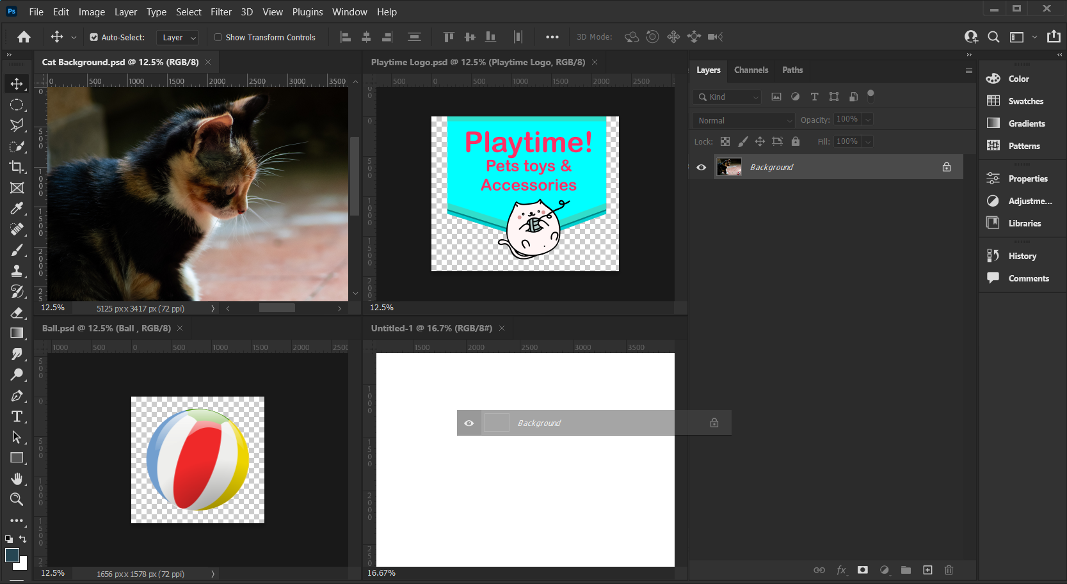
Bringing image into new file
Click on active file or layer of active file
drag and drop into Cat Background file
Hold Shift + Drag + Drop to centre image in Cat Background

Slide 9
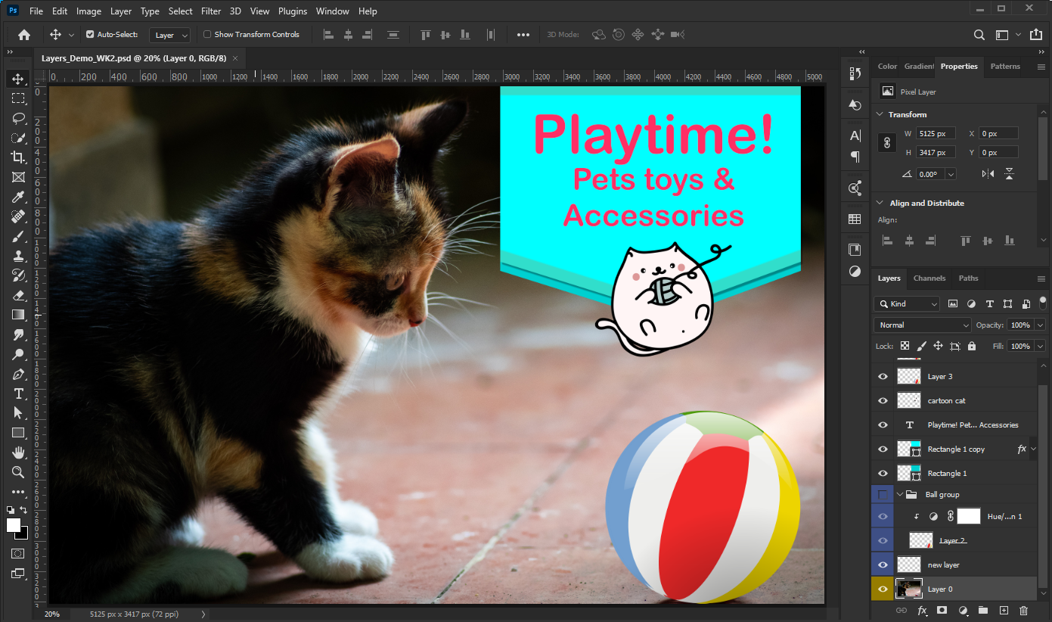
Layers Panel
The stacking order in the Layers panel matches the order in which they appear in the image
i.e. the image in furthest in the background will also be at the bottom o the layers panel
Background of image is at the bottom of the layers stack

Slide 10
Layers Panel Selecting a layer
Click on a layer to select it
Currently active layer

Slide 11
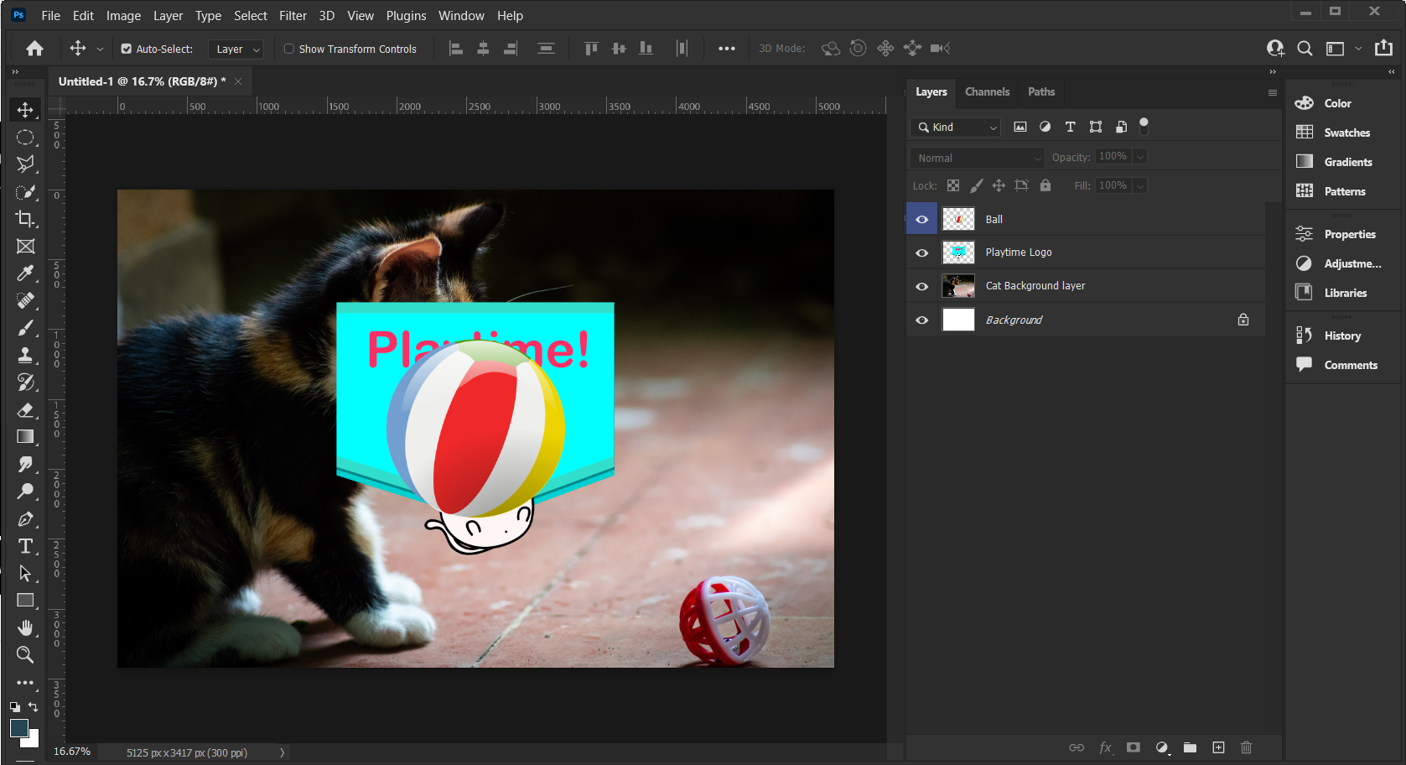
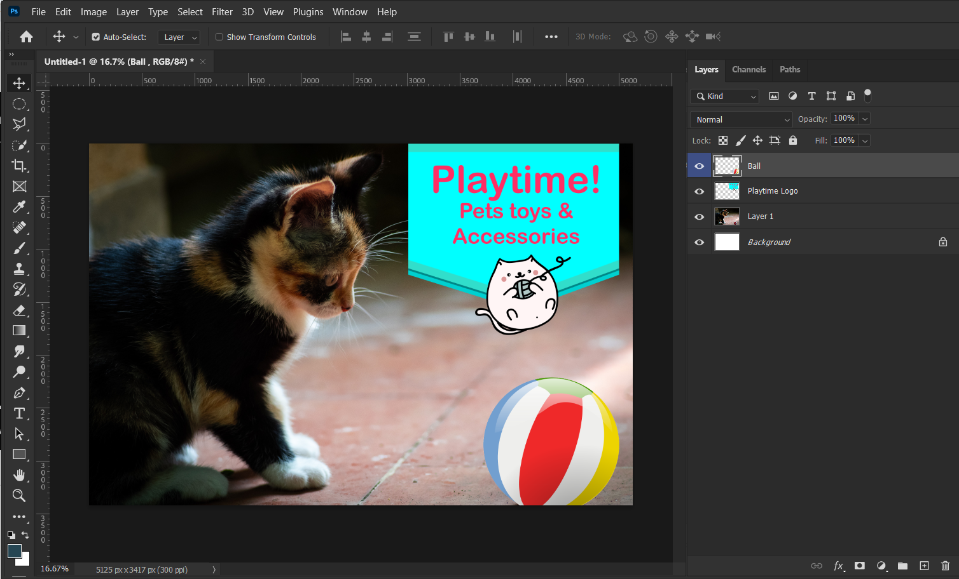
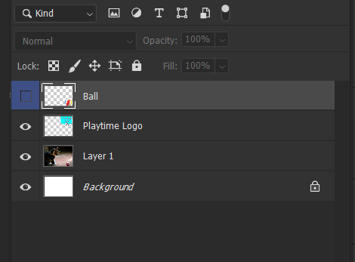
Moving Layers
Repeat with other layers and close all windows except the Cat Background file
Double-click on layer 1 and rename
Target ball and logo files, Drag them into the Cat Background file and move them into place in the stacking order
Use the Move Tool to place them in the image, make sure the image you are moving is targeted on the layers panel
Control layer visibility by turning eye-ball on or off

Slide 12
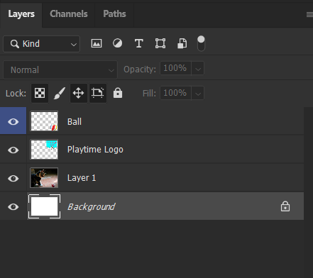
Background Layer
A Background layer is always at the bottom of the stack when you create a new blank document or open an image
Identified by italics and is locked
Although photoshop always adds a background layer (unless you are using artboard option) your image does not need to include a background layer
To move or manipulate a background
layer double-click on it
Background layer

Slide 13
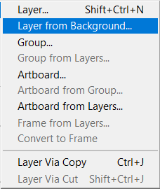
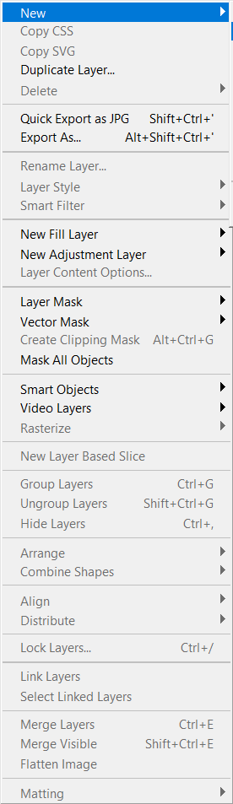
Converting background Layer and back again
Convert a Background layer into an Image layer to edit its content
Convert an Image layer into a Background layer to make it the bottom layer
  Layer > New > Background from Layer or double click on background layer in layers panel

Slide 14
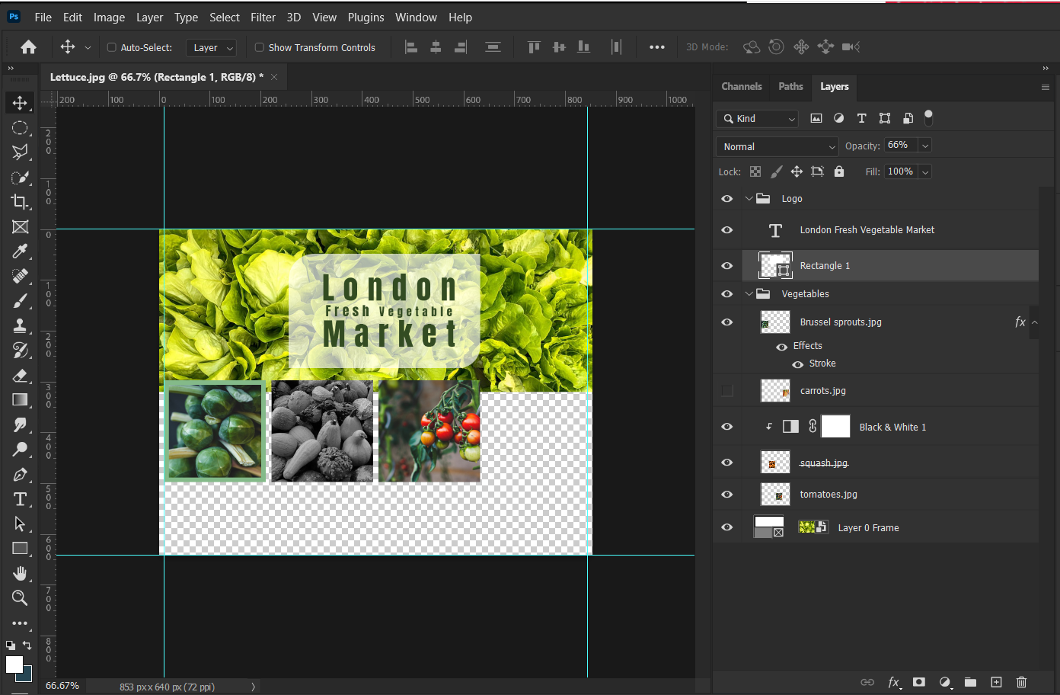
Using Layers – Example 2

Slide 15

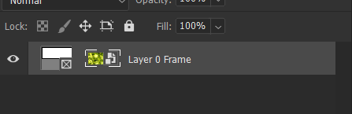
Using Frame tool with layers
  The Frame tool allows you to non-destructively
  hide part of a layer
Use text frame tool to draw mask over layer
Target mask icon to manipulate mask
Target image icon to manipulate image
Target layer to move both

Slide 16
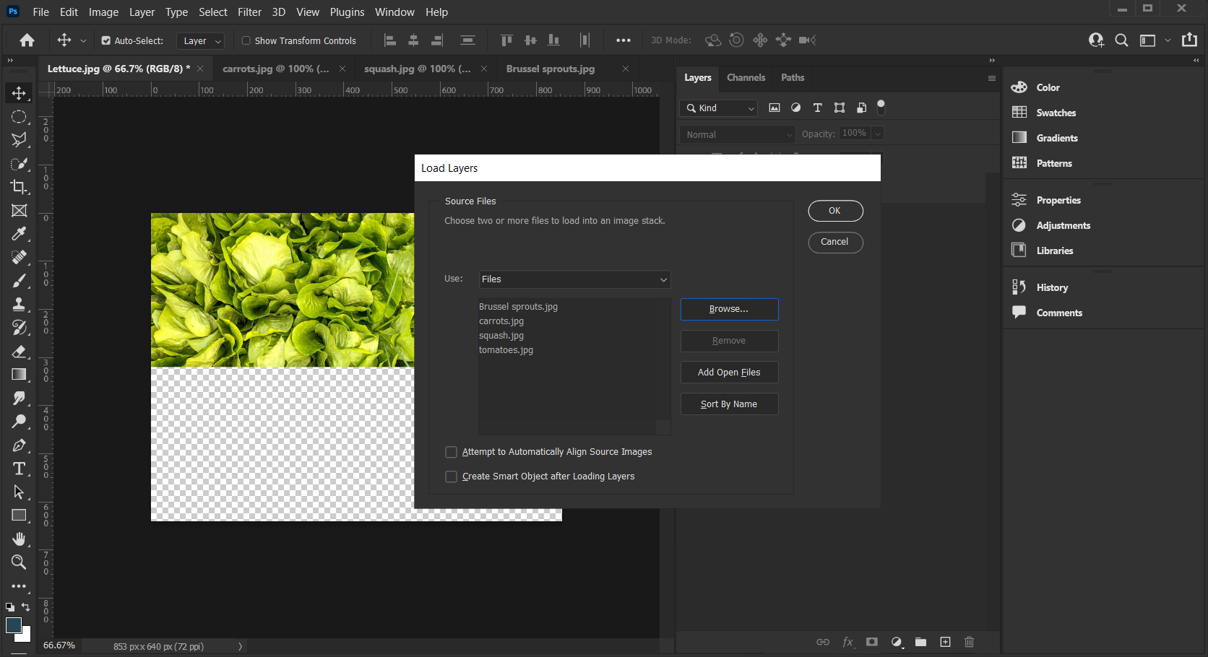
Load multiple files into layers
  To load multiple files into the open photoshop document
  Files>scripts>load files into stack
  Find the files and alt + ctrl click to choose files you want to load

Slide 17
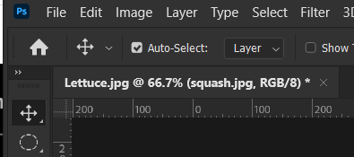
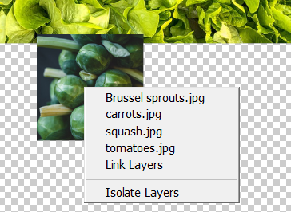
Selecting layers
  To select layer, you can target the layer (as we discussed) or with the move tool selected check off “Auto-Select” (or hold down Ctrl (Cmd) key with move tool. You will be able to select the image you are currently hovering over
Move tool
  right click over an image to choose that image or any layer below it

Slide 18
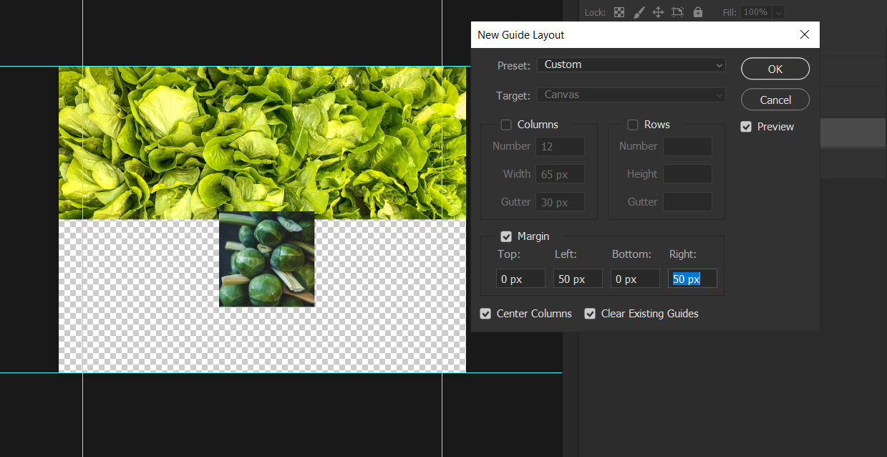
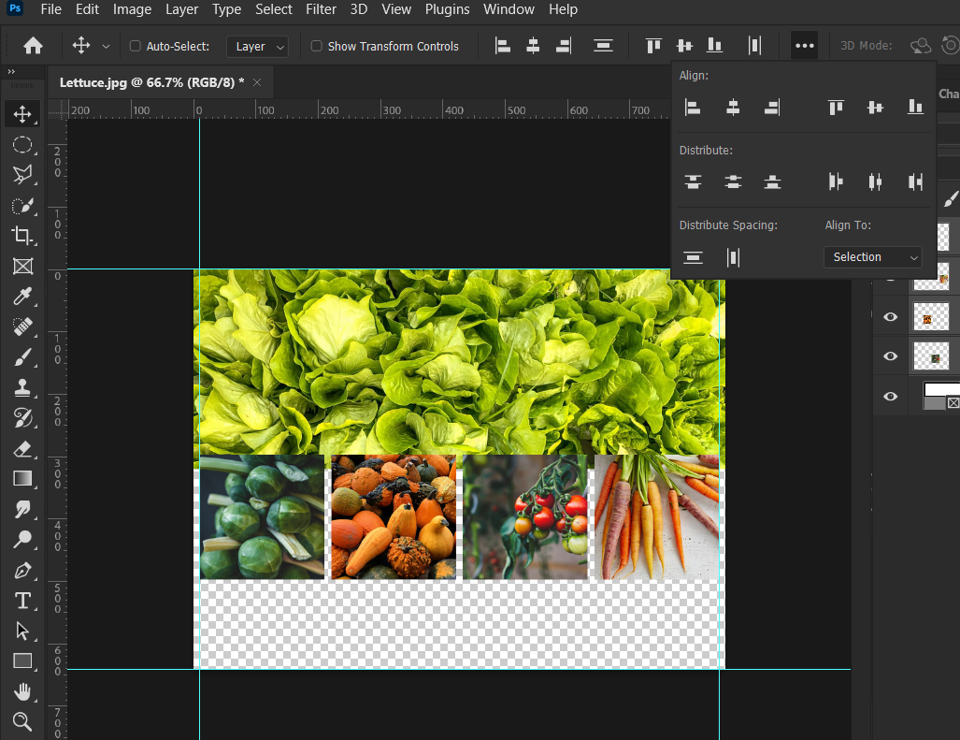
Align and Distribute layers
  Create guides for you document View>New Guide layout,
  set left and right margins at 10px
  Move one image to left margin
  and one to right margin
  Select all 4 images and use the
  align/distribute commands to
  move layers
Align/Distribute available when move tool Selected

Slide 19
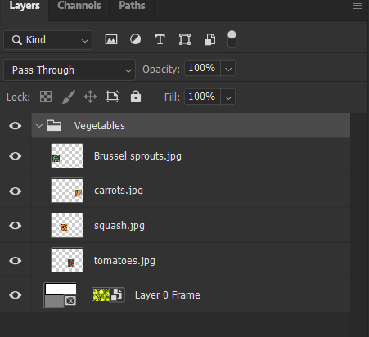
Organize layers – Creating Groups
  Organize layers into group multiple ways, choose layers to be grouped and:
  Drag down to folder icon
  Layers>Group layers
  Ctrl/Cmd + G
Twirl arrow up or down to open or close group

Slide 20
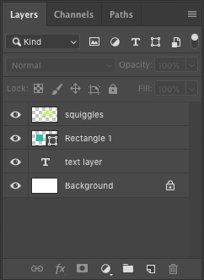
Adding New Layers
Add layers in three ways:
  Use the New command on the Layer menu
    Layer > New > Layer
  Click the Create a new layer button on the Layers panel
  Shift+Ctrl (Cmd)+N
Photoshop names new layers consecutively starting with
Layer 1

Slide 21
Naming Layers
Name a layer to easily identify its purpose in the image
To change a layer name:
  Access Layer Properties
  Double-click the layer name in the Layers panel and type a new name

Slide 22
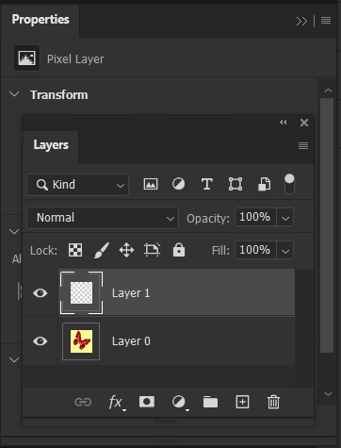
Deleting Layers
  Use the flyout layers panel menu and choose delete
  Select the layer and click the delete layer button (garbage can) or drag the layer name to the delete layer button
  Choose layer and hit delete or backspace key on your keyboard

Slide 23
Adding Color-code to a Layer
Color-code layers to organize
them
Existing layer :
Right click on layer icon and
change colour from menu
New layer:
Alt (Opt) + new layer will bring up
dialogue box where you can select colour

Slide 24


Stacking Order
Change the order of layers
Triangle behind Ink
Triangle in front of Ink

Slide 25
Summary – Types of Layers
Add layer style (e.g stroke)
Type Layer
Shape Layer
Adjustment Layer
Image Layer
Add, delete, and move layers

Slide 26
What Else Can you Do With Layers?
Change opacity of layer
Hide and display layers
Add, delete, and move layers

Slide 27
Types of Layers
Type Layer - Contains text; Identified by the type
layer icon
Image Layer - Contains non-text items; Identified by a thumbnail
of its contents
Shape Layer - Create rectangles, rounded rectangles, Ellipse, Polygons, lines or create custom shapes
Adjustment Layer - Change or alter an image by change hue,
Vibrance, Brightness, saturation etc.
Layer Effect - Add a special effect to layer such as drop
Shadow, Inner Glow, Stroke etc.

Slide 28

Zoom Tool
Use the Zoom tool to zoom in and out—up to a maximum of 1600%
Keyboard shortcut “Z”
Or just use ctrl or cmd + (plus) or – (minus) to zoom out
Switch Zoom in to Zoom out by holding Alt or Opt
Ctrl/cmd + 1 = 100%
Ctrl/cmd+ 0 = fit document to window
Notes:
Or ’ctrl’ + ‘+” to zoom in and ‘-’ to zoom out
cmd for mac users

Slide 29
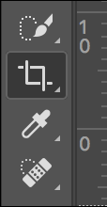
Cropping an Image
Use the Crop tool on the Tools panel to remove a portion of an image:
  Click the Crop tool, photoshop automatically adds a crop around the whole image
  Size the crop area to what ever size you need, hold shift + drag to keep cropped area in proportion
  Drag the pointer to move image within cropped area
  Press [Enter] (Win) or [return] (Mac)
  Crop by eye, ratio or pixel dimensions
  Option to delete pixels permanently or not.
  Non-permanent cropping can only be retained in
  .psd file format.

Slide 30
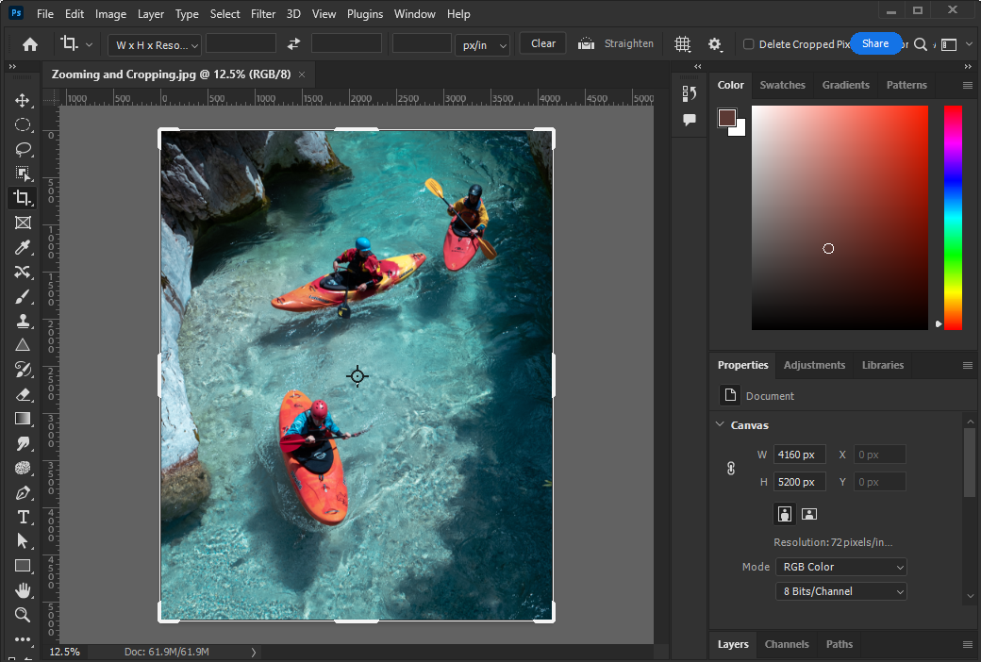
The cropping interface
Choose aspect ratio to create crop
Enter pixel value
Permanently Delete cropped pixels

Slide 31
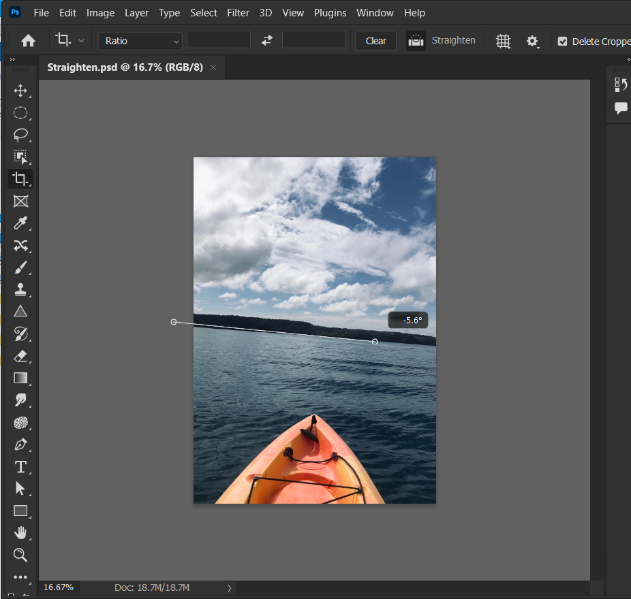
Straighten an image
Straighten
Select the crop tool
Select Straighten from the options bar
Drag the line across the existing “crooked” line to make it straight

Slide 32
Introduction to Masking and Selections
In Photoshop you can choose certain parts of an image, this is called making a selection. There are many ways to make a selection.
Also in photoshop you can show or hide parts of an image this is called masking.
Masking allows us to work non-destructively.
To make a mask you must first select what part of an image you want to show or hide

